Slide 1

Data Analytics
311 Reports
Smart LA Project
Imaad Khan; Peipei Han; Shuhan Zhou;
Yifan Wu; Yuzhou Dou

Slide 2
AGENDA
Basic
Distribution
Time Series
Efficiency
Map with
Real-time data
Smart LA
Suggestions

Slide 3

Basic
Distribution
01

Slide 4
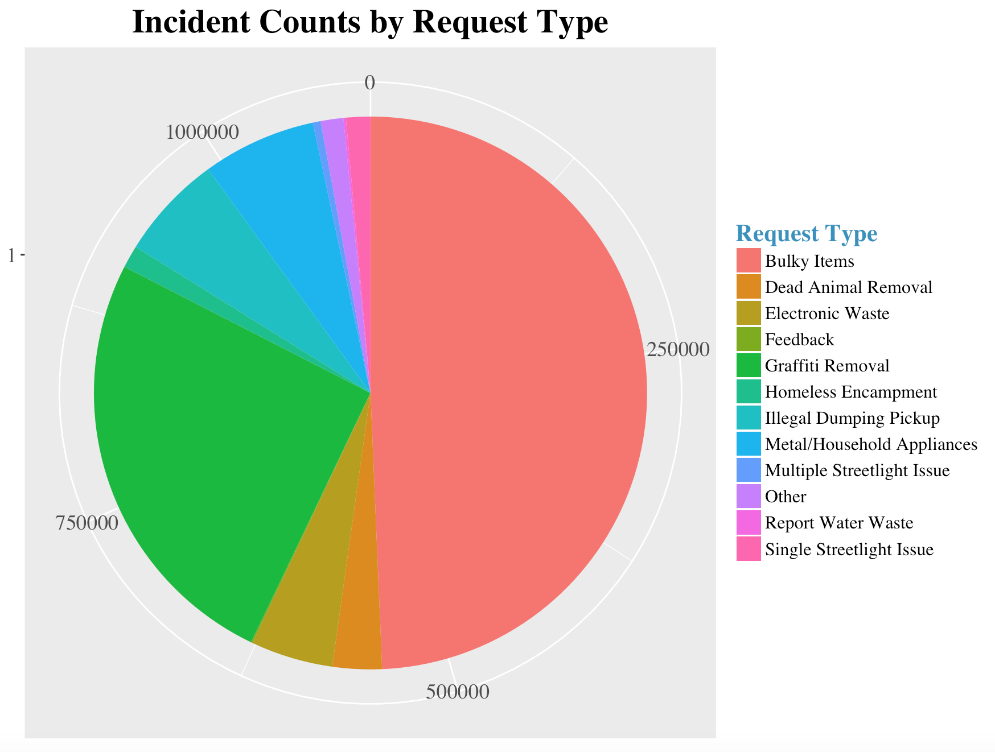
Request Type Distribution
1
Basic
Distribution
2
Time Series
Efficiency
3
Map with
Real-time Data
4
Smart LA
Suggestions

Slide 5
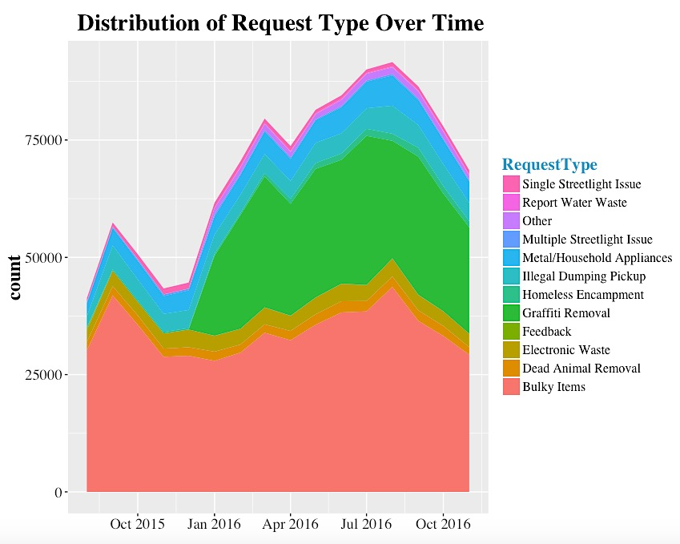
Request Type Distribution
1
Basic
Distribution
2
Time Series
Efficiency
3
Map with
Real-time Data
4
Smart LA
Suggestions

Slide 6
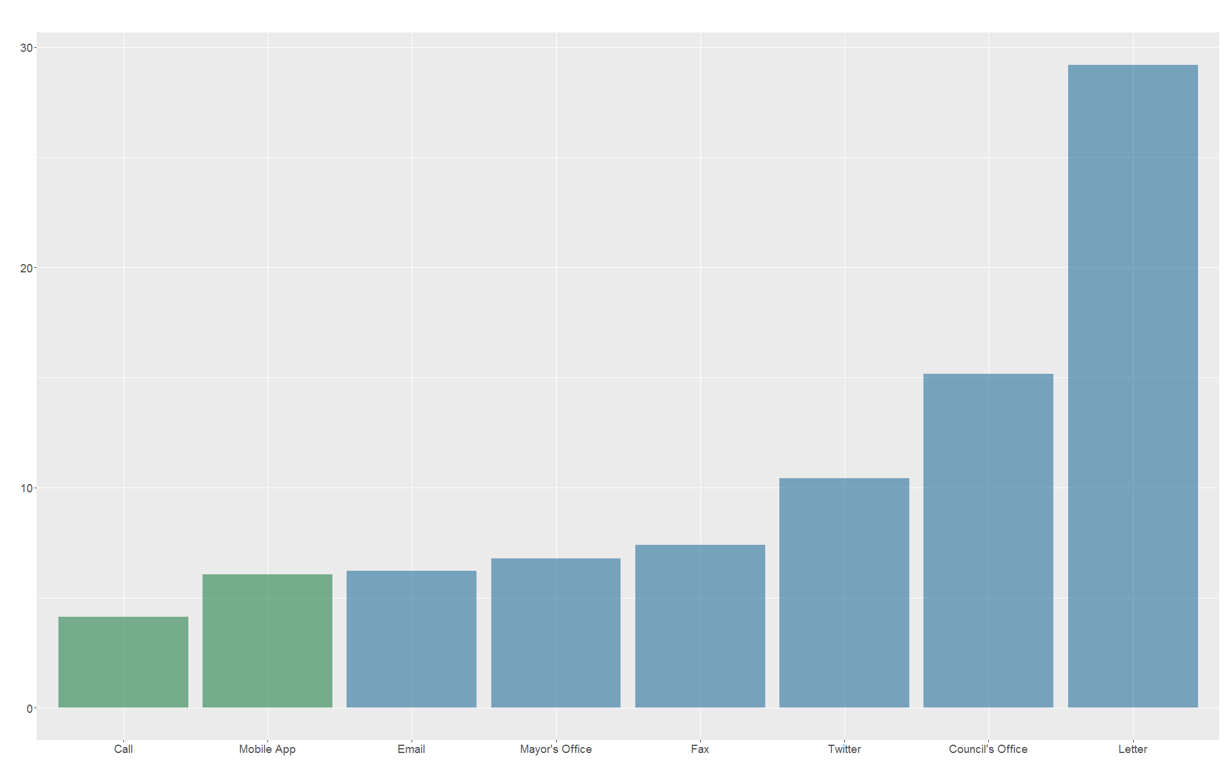
Handle Time by Sources
Handle Time by Request Source
1
Basic
Distribution
2
Time Series
Efficiency
3
Map with
Real-time Data
4
Smart LA
Suggestions

Slide 7
Time Series
Efficiency
02

Slide 8
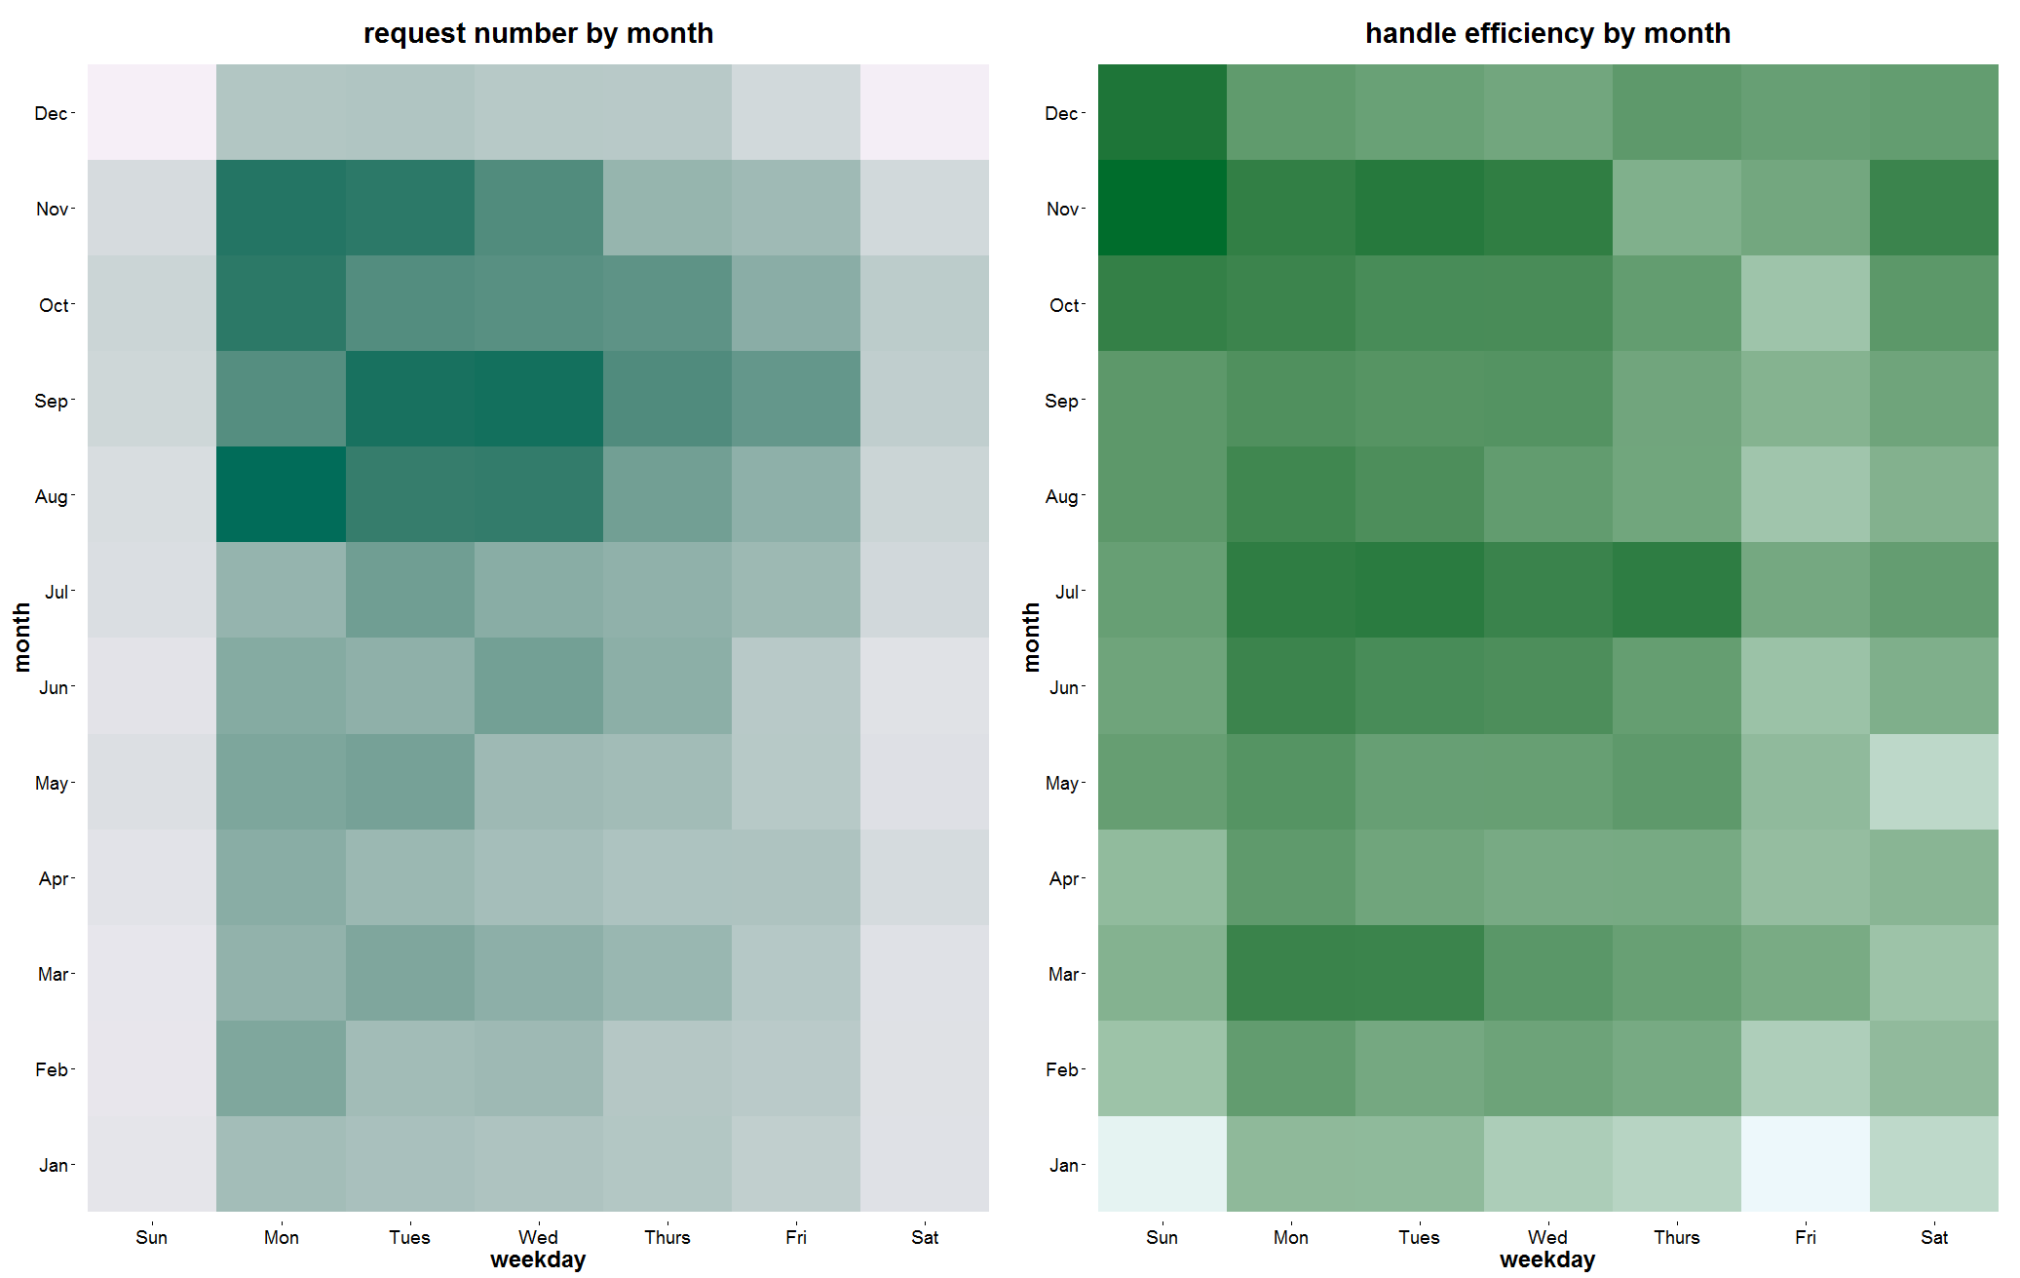
Heatmap of request and handle
Overview
Basic Distribution
Time Series/Efficiency
Maps
City Planning
Summary

Slide 9
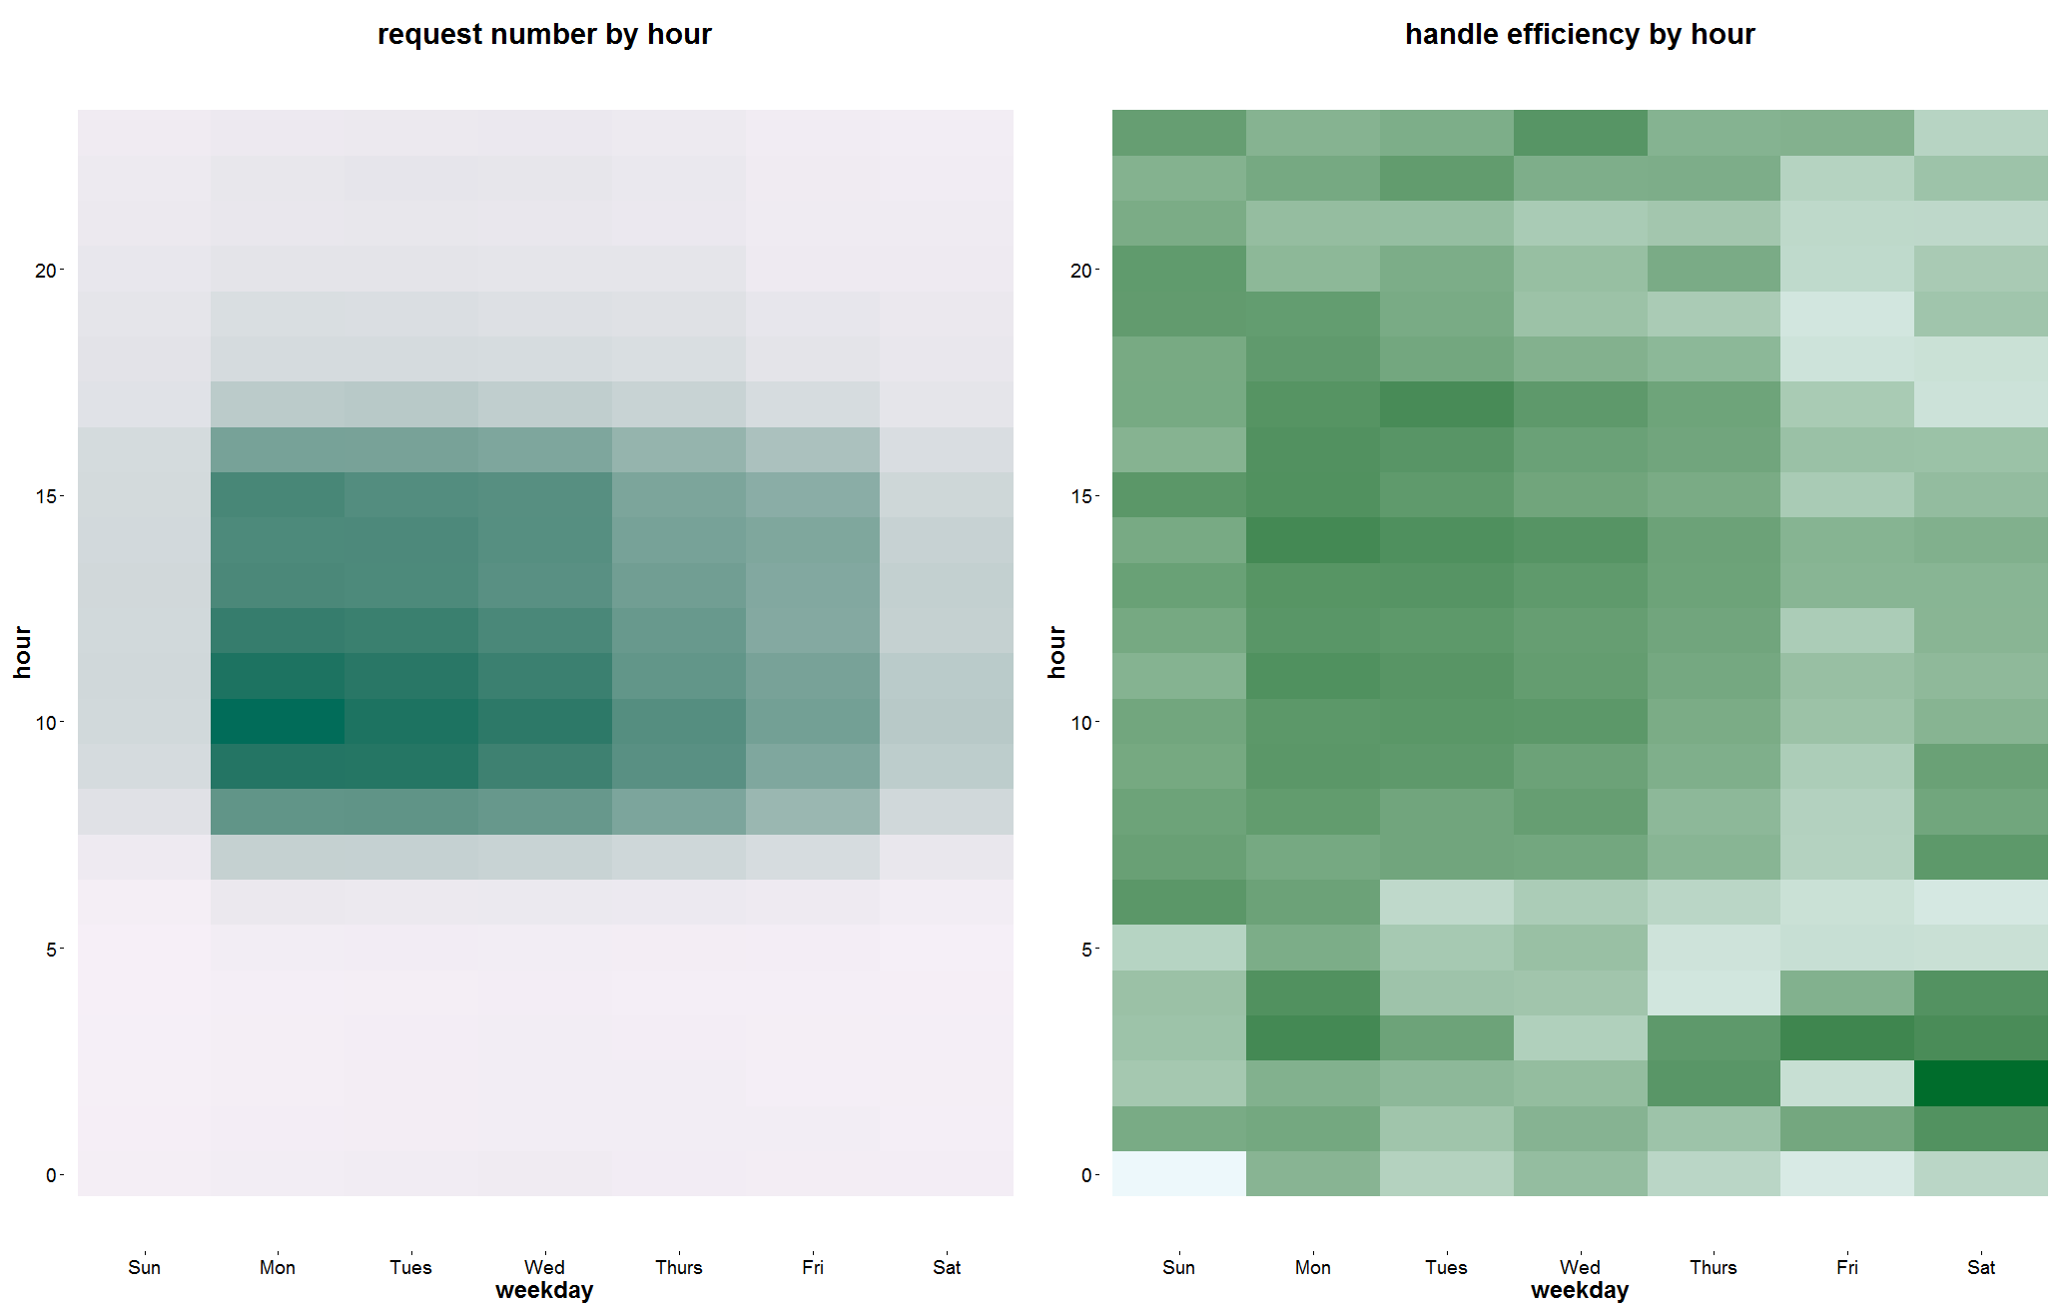
Heatmap of request and handle
Overview
Basic Distribution
Time Series/Efficiency
Maps
City Planning
Summary

Slide 10
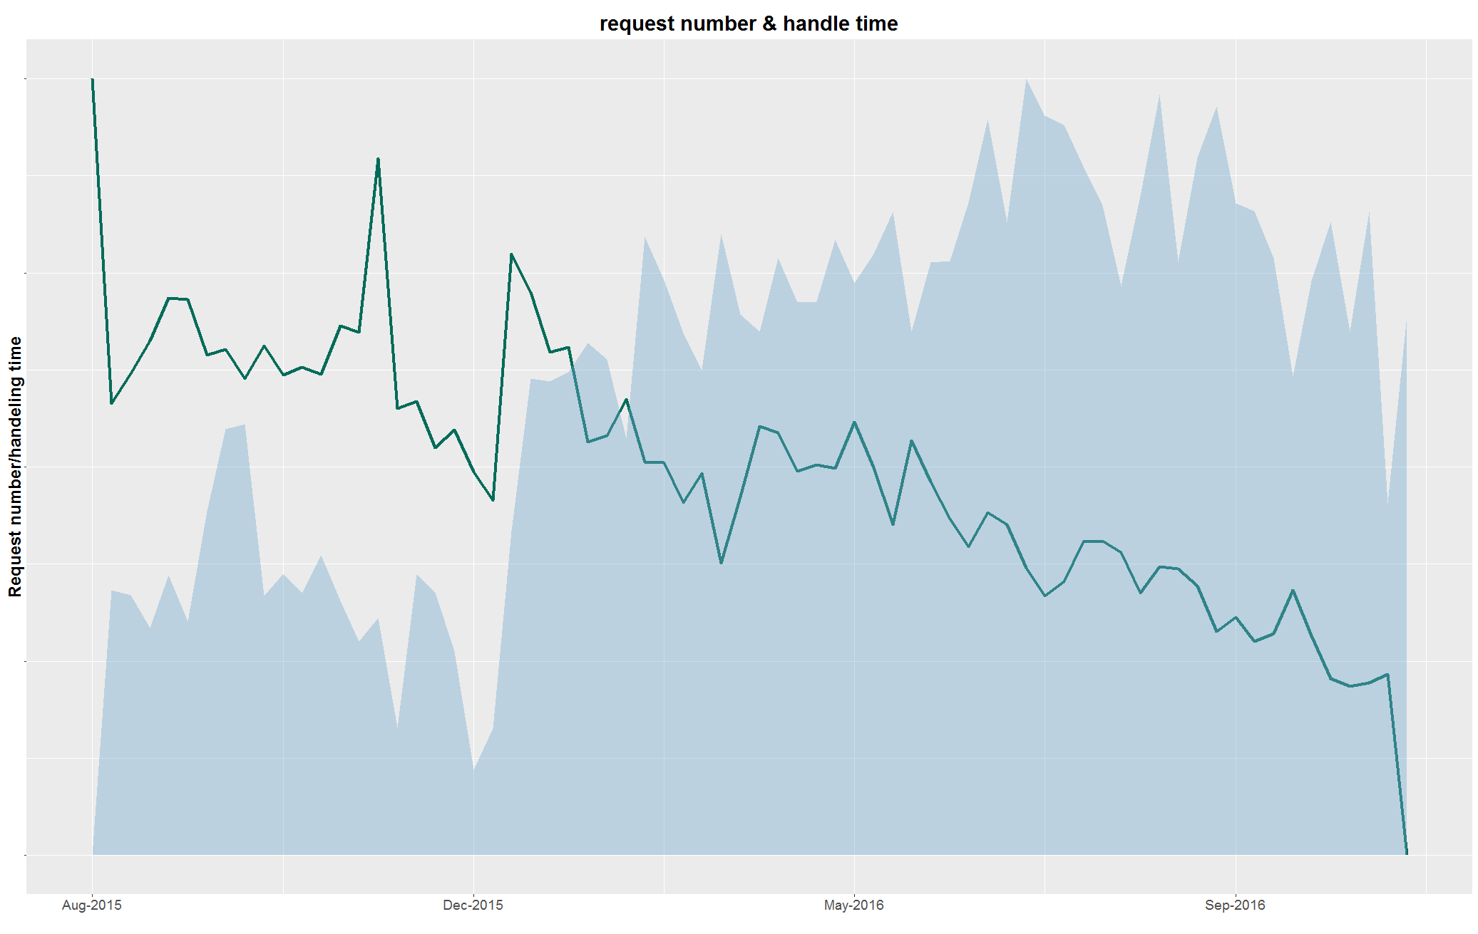
Time Series of impact and efficiency
Overview
Basic Distribution
Time Series/Efficiency
Maps
City Planning
Summary

Slide 11
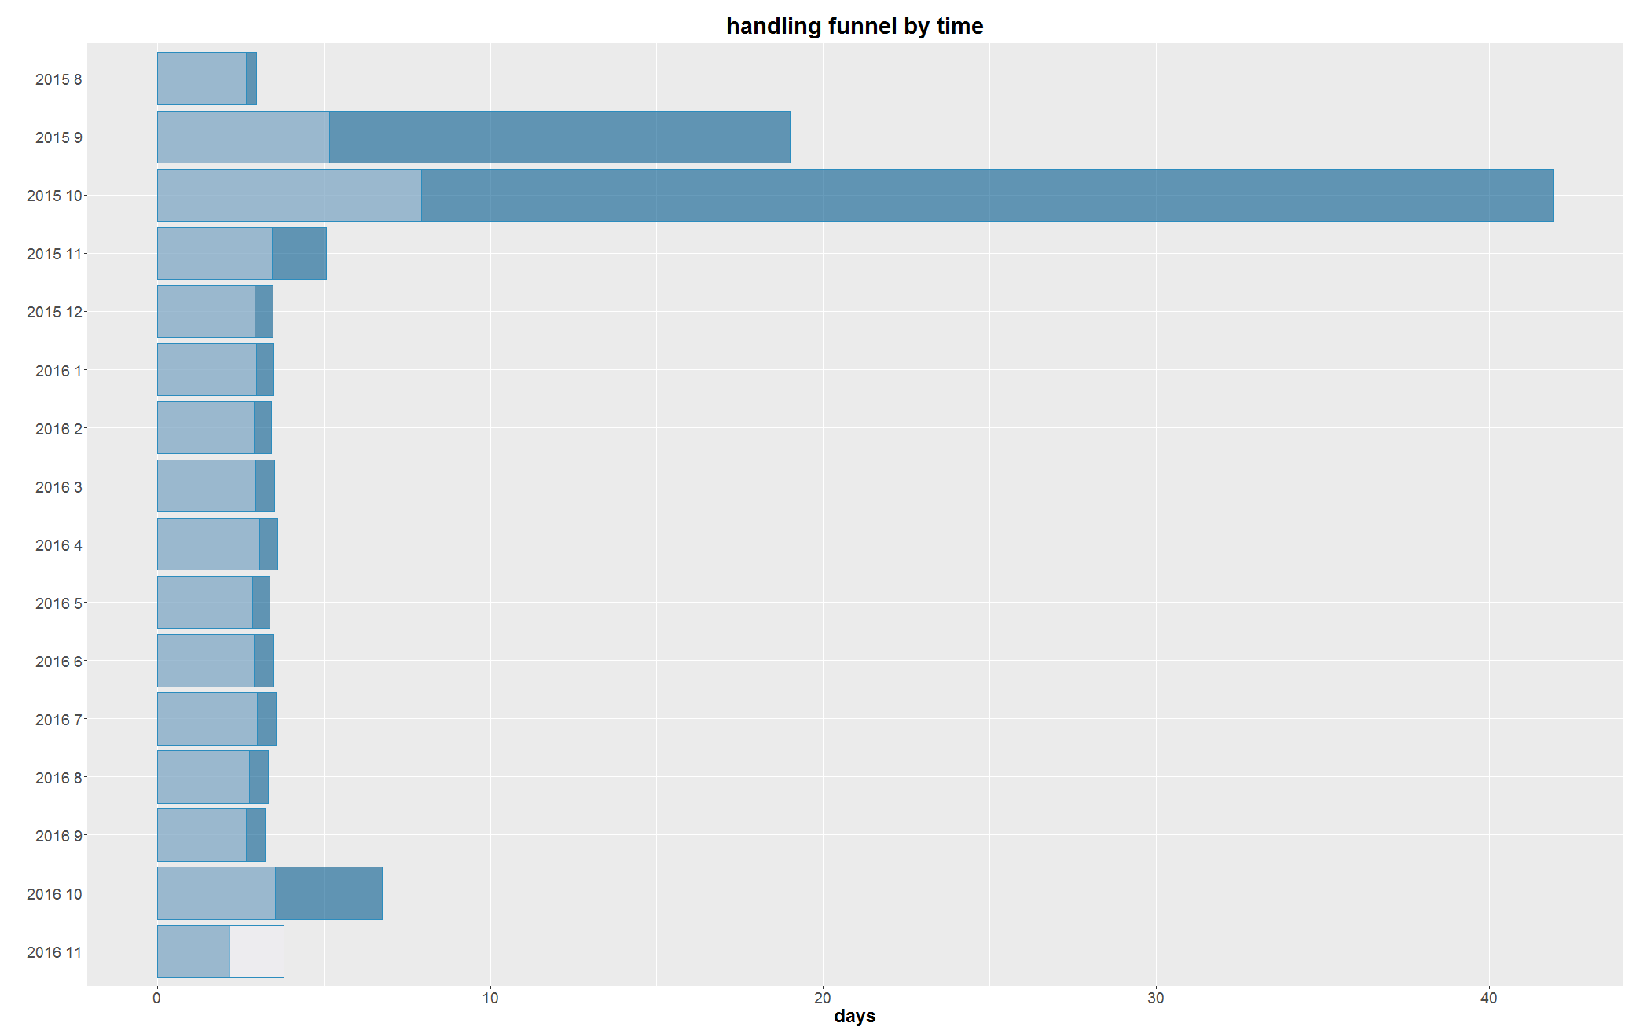
Time Series of impact and efficiency
Overview
Basic Distribution
Time Series/Efficiency
Maps
City Planning
Summary

Slide 12
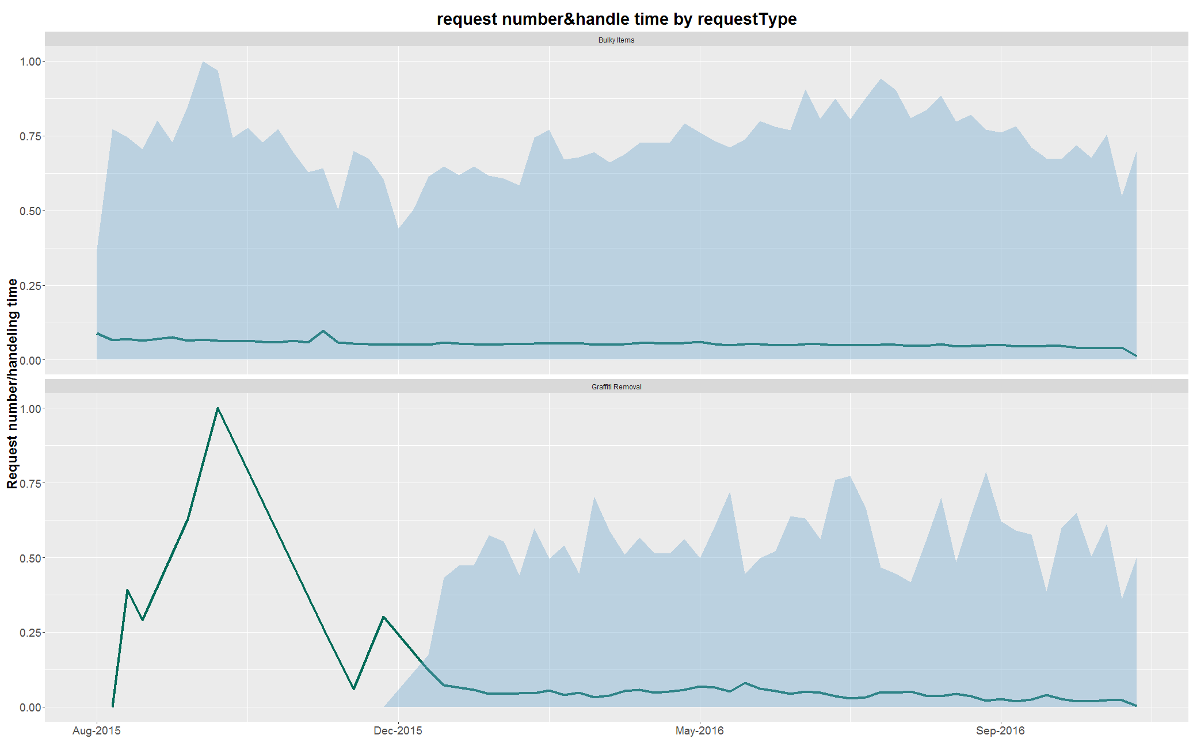
General Pattern – frequent request
Overview
Basic Distribution
Time Series/Efficiency
Maps
City Planning
Summary

Slide 13
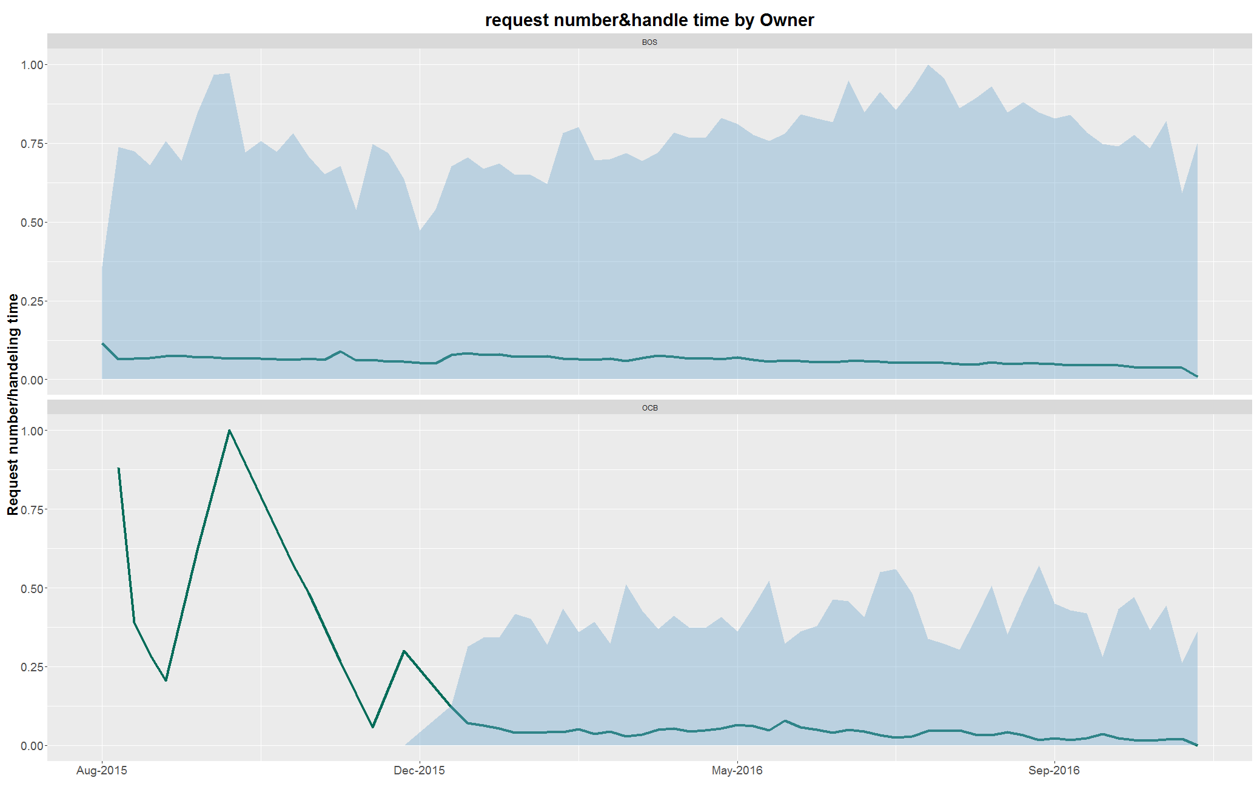
General Pattern – star department
Overview
Basic Distribution
Time Series/Efficiency
Maps
City Planning
Summary

Slide 14
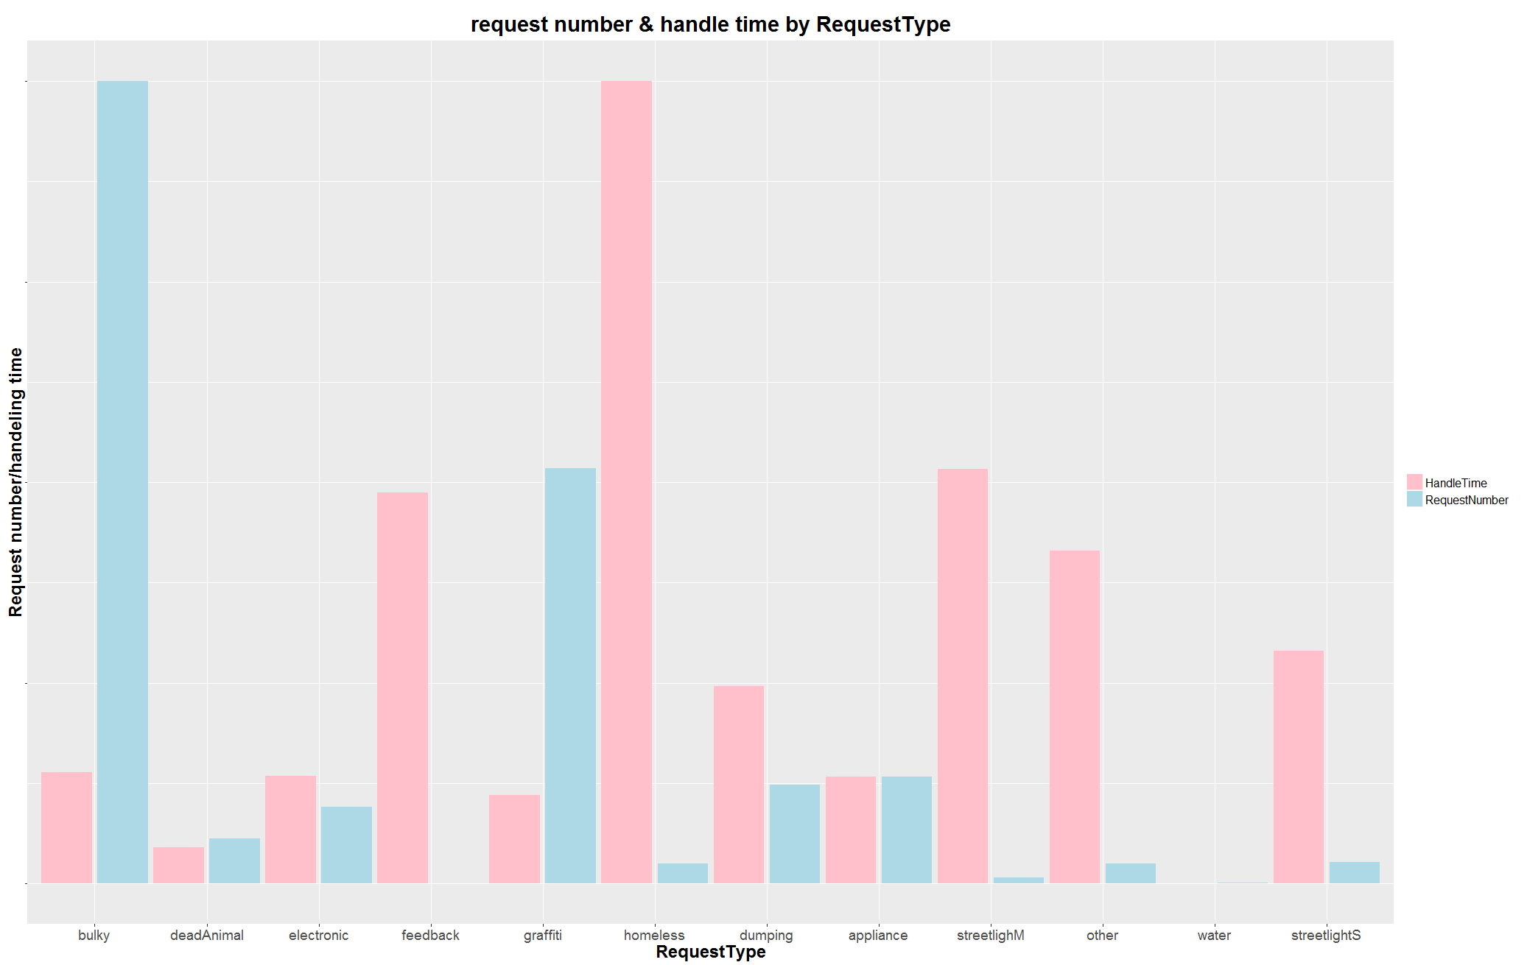
Matching department with request
Overview
Basic Distribution
Time Series/Efficiency
Maps
City Planning
Summary

Slide 15
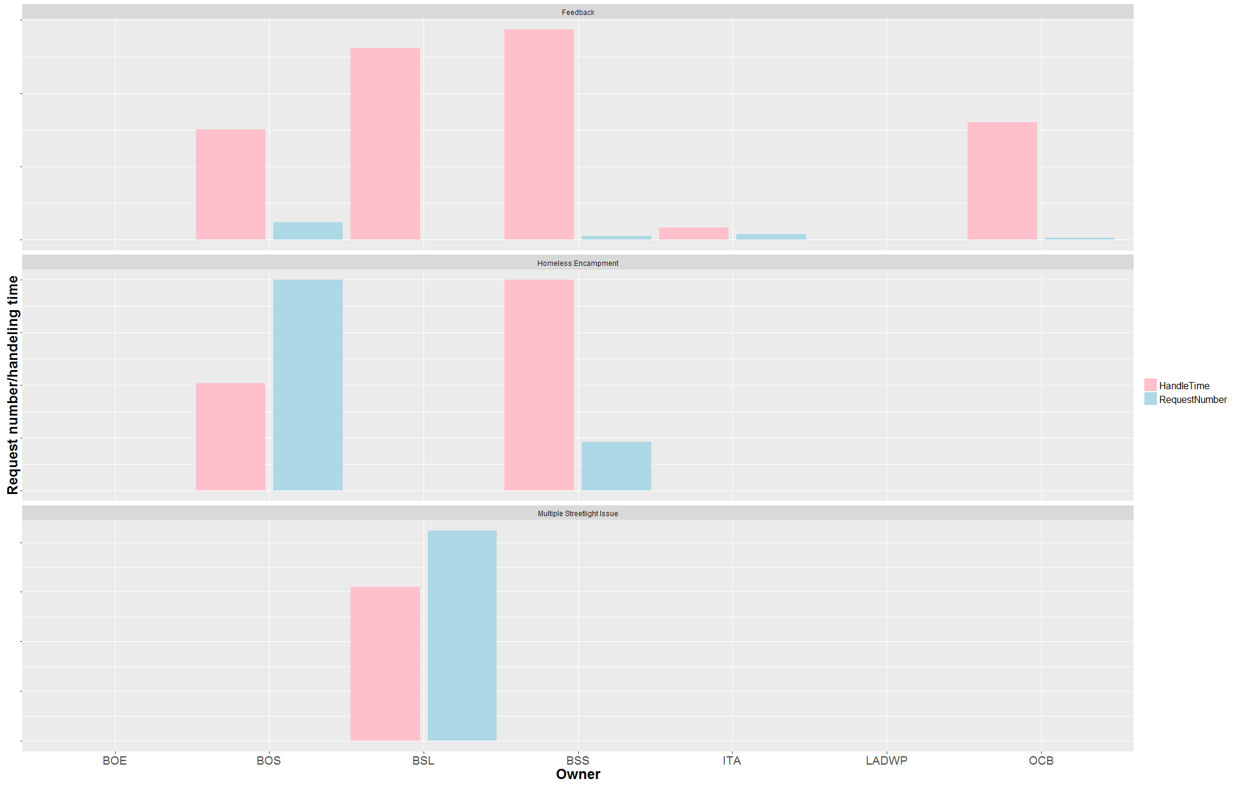
Matching department with request
Request Number & Handle Time by RequestType
Overview
Basic Distribution
Time Series/Efficiency
Maps
City Planning
Summary

Slide 16
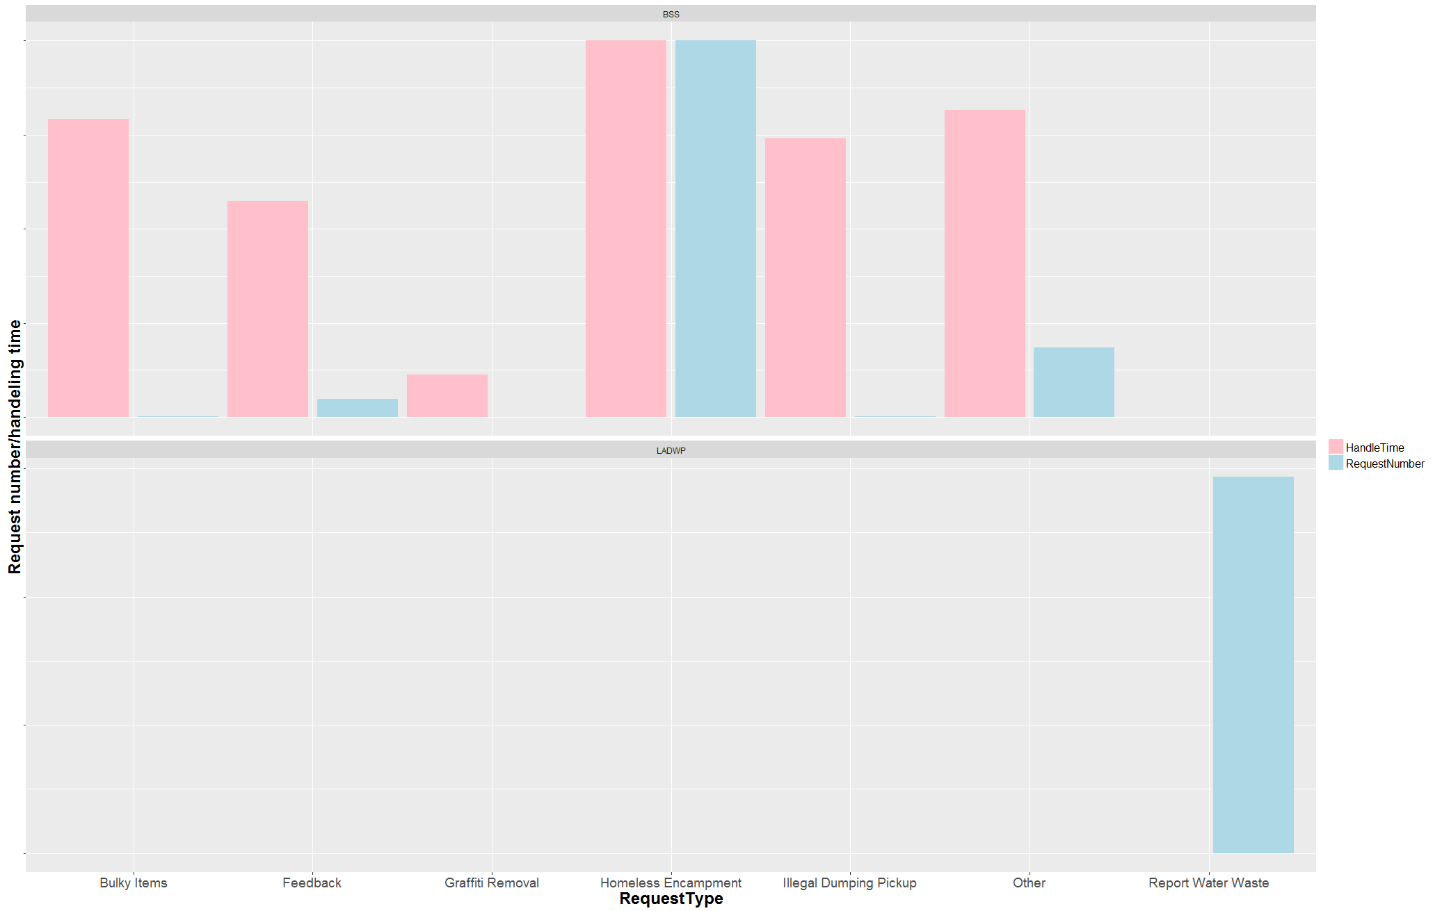
Matching department with request
Request Number & Handle Time by Owner
Overview
Basic Distribution
Time Series/Efficiency
Maps
City Planning
Summary

Slide 17
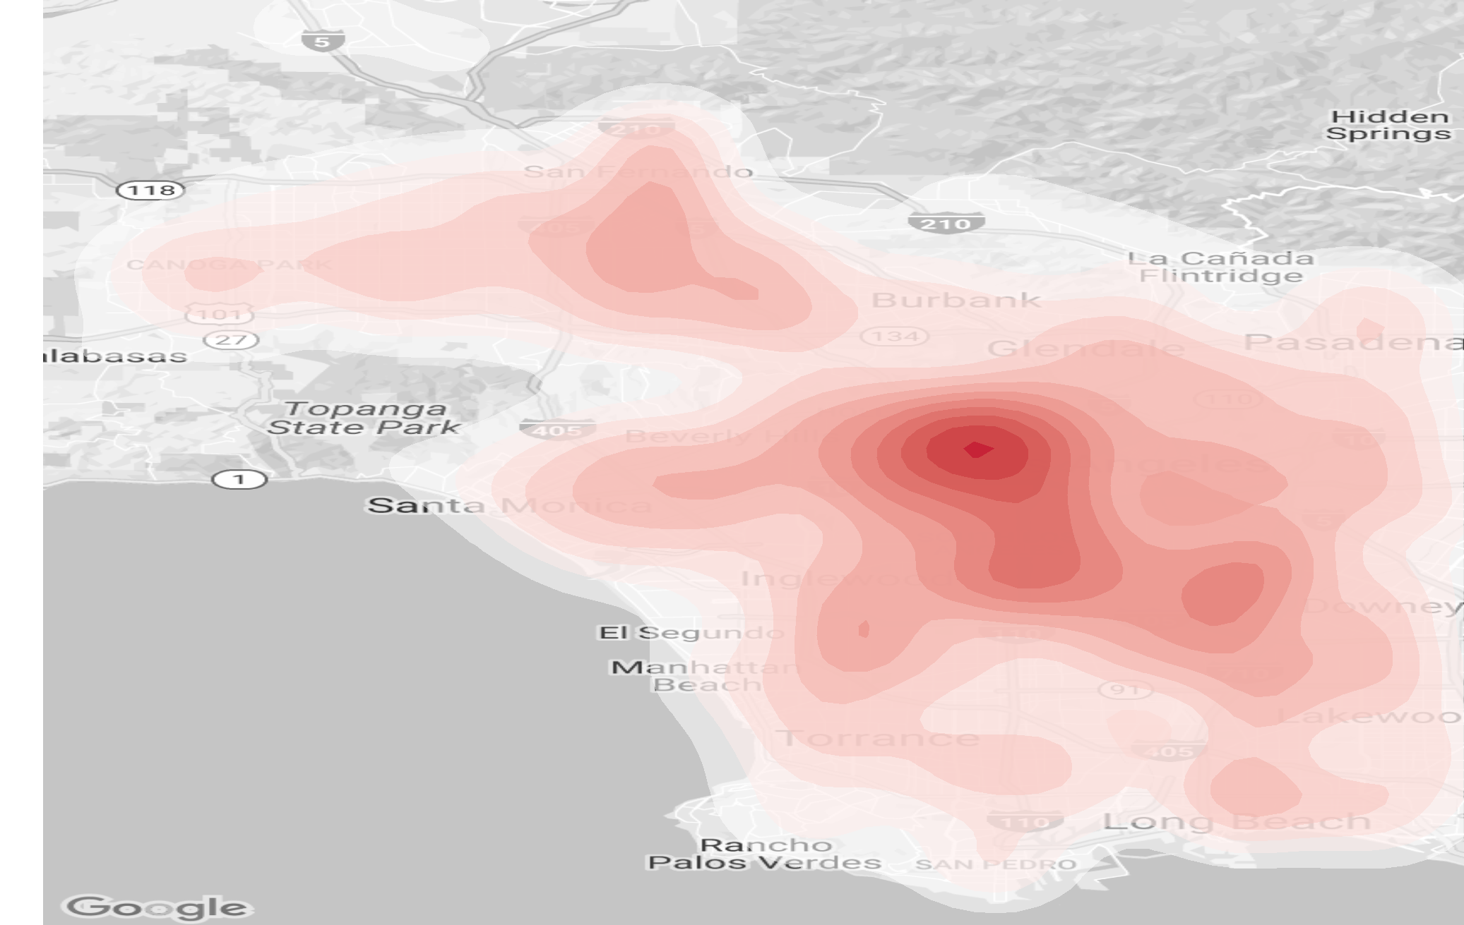
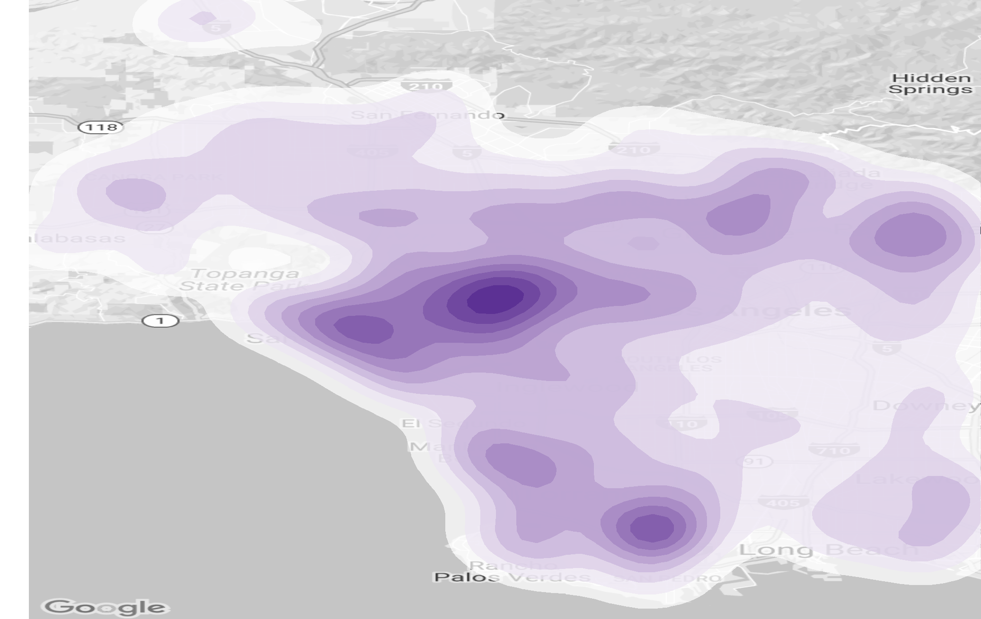
Background map
Population Contour
Income Contour
Overview
Basic Distribution
Time Series/Efficiency
Maps
City Planning
Summary

Slide 18
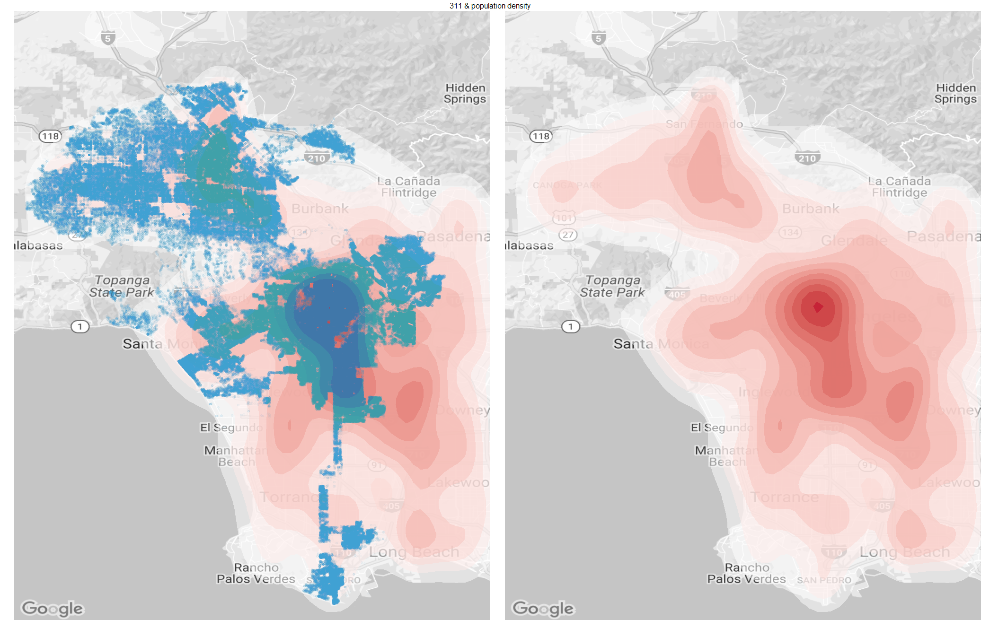
General pattern – with population
Overview
Basic Distribution
Time Series/Efficiency
Maps
City Planning
Summary

Slide 19
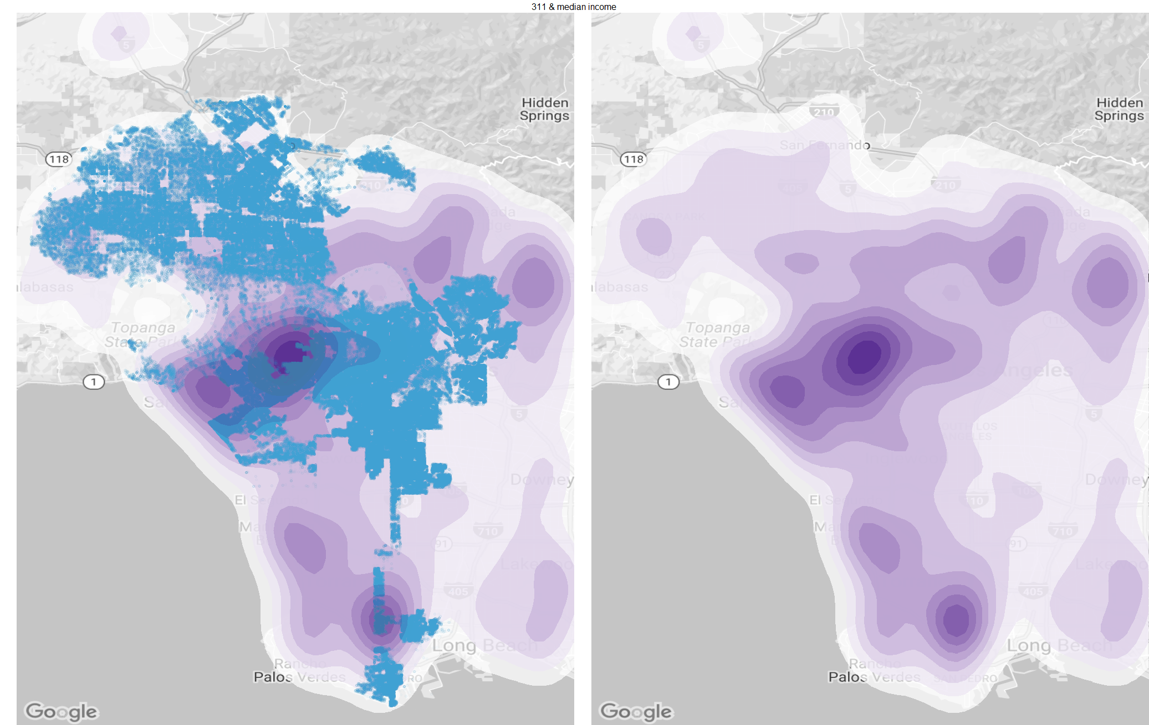
General pattern – with income
Overview
Basic Distribution
Time Series/Efficiency
Maps
City Planning
Summary

Slide 20
Abnormality
Overview
Basic Distribution
Time Series/Efficiency
Maps
City Planning
Summary

Slide 21
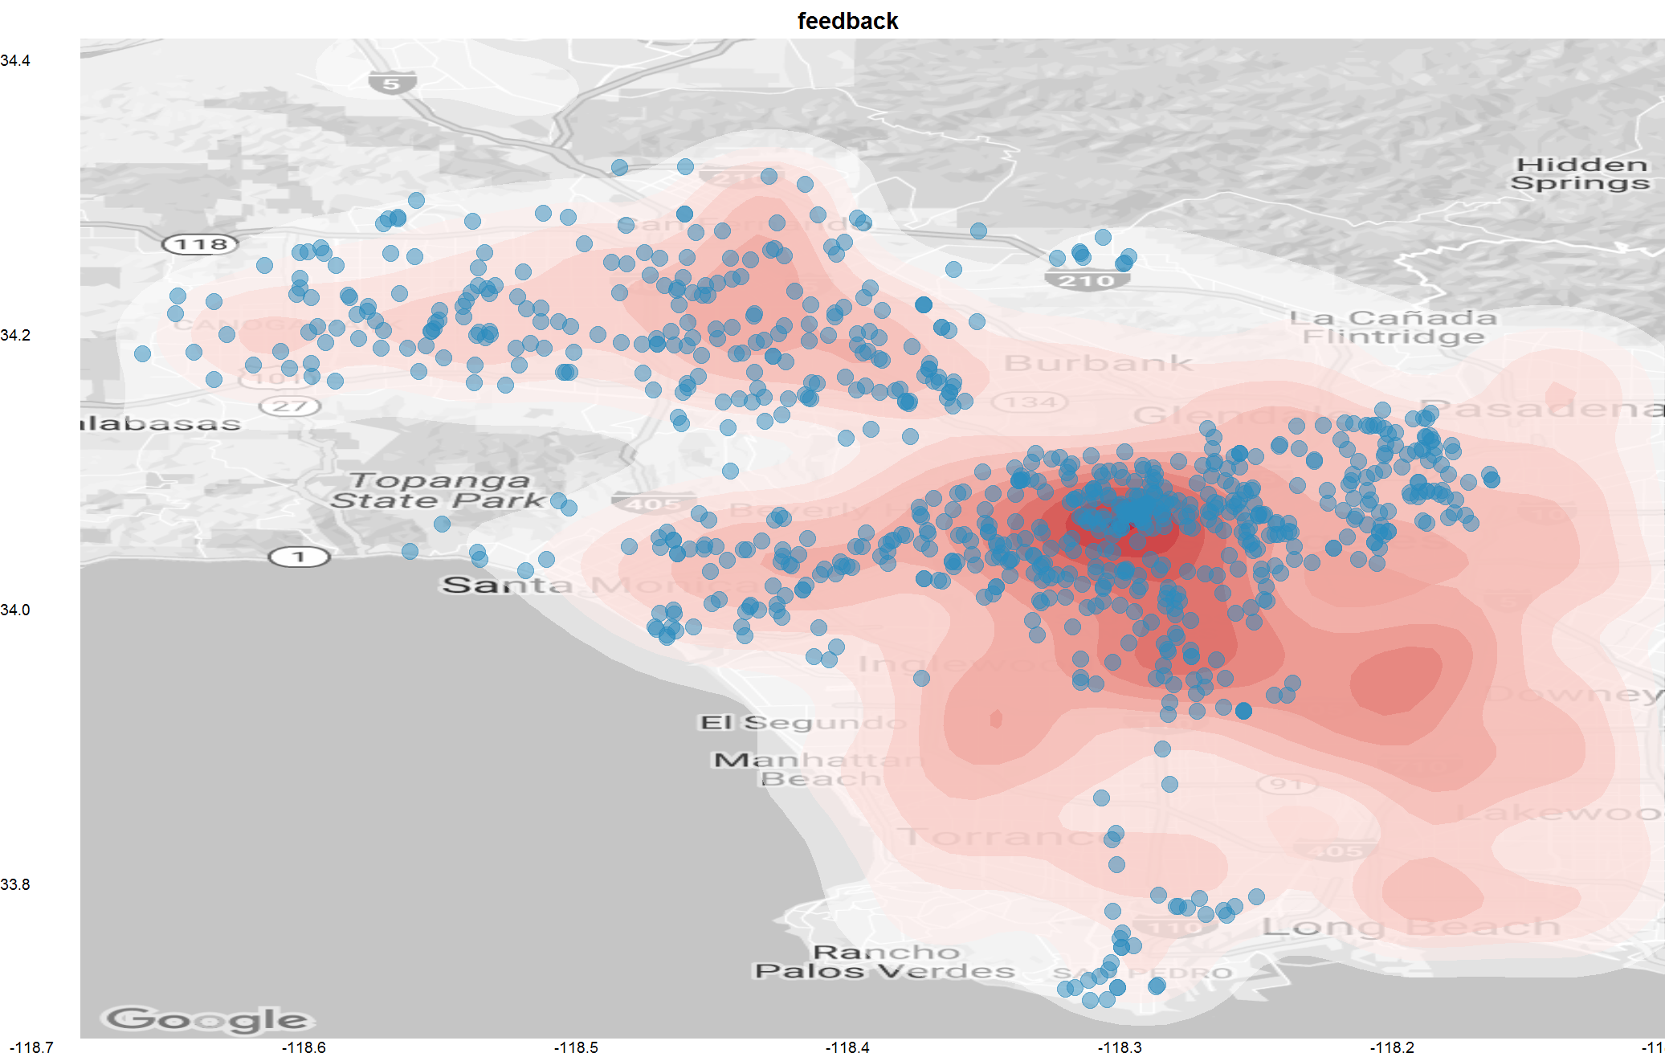
General Pattern - Feedback
Overview
Basic Distribution
Time Series/Efficiency
Maps
City Planning
Summary

Slide 22
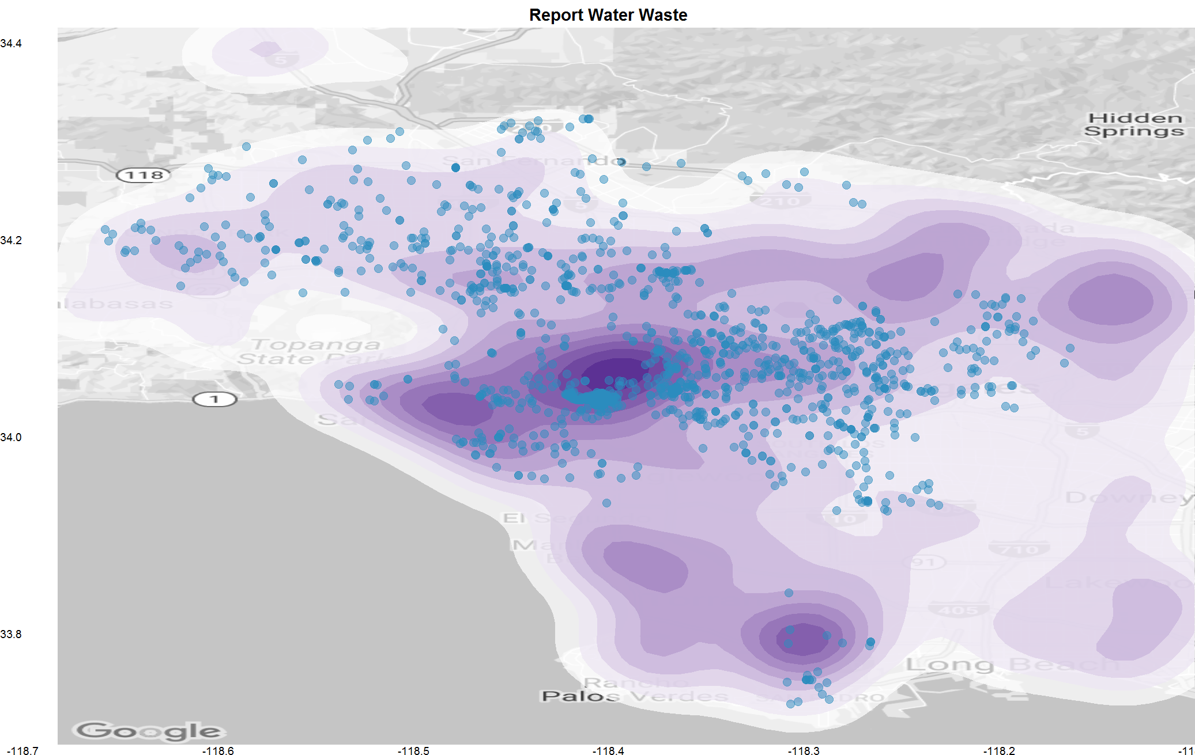
General pattern – Water Waste
Overview
Basic Distribution
Time Series/Efficiency
Maps
City Planning
Summary

Slide 23
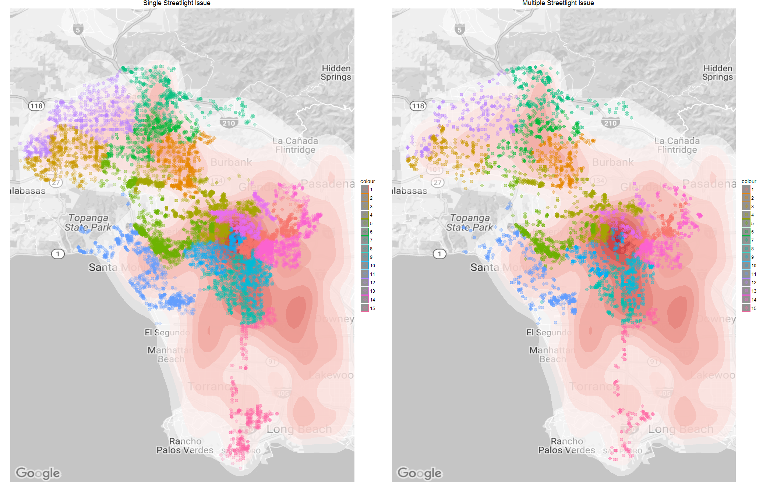
Special features – streetlight issue
Overview
Basic Distribution
Time Series/Efficiency
Maps
City Planning
Summary

Slide 24
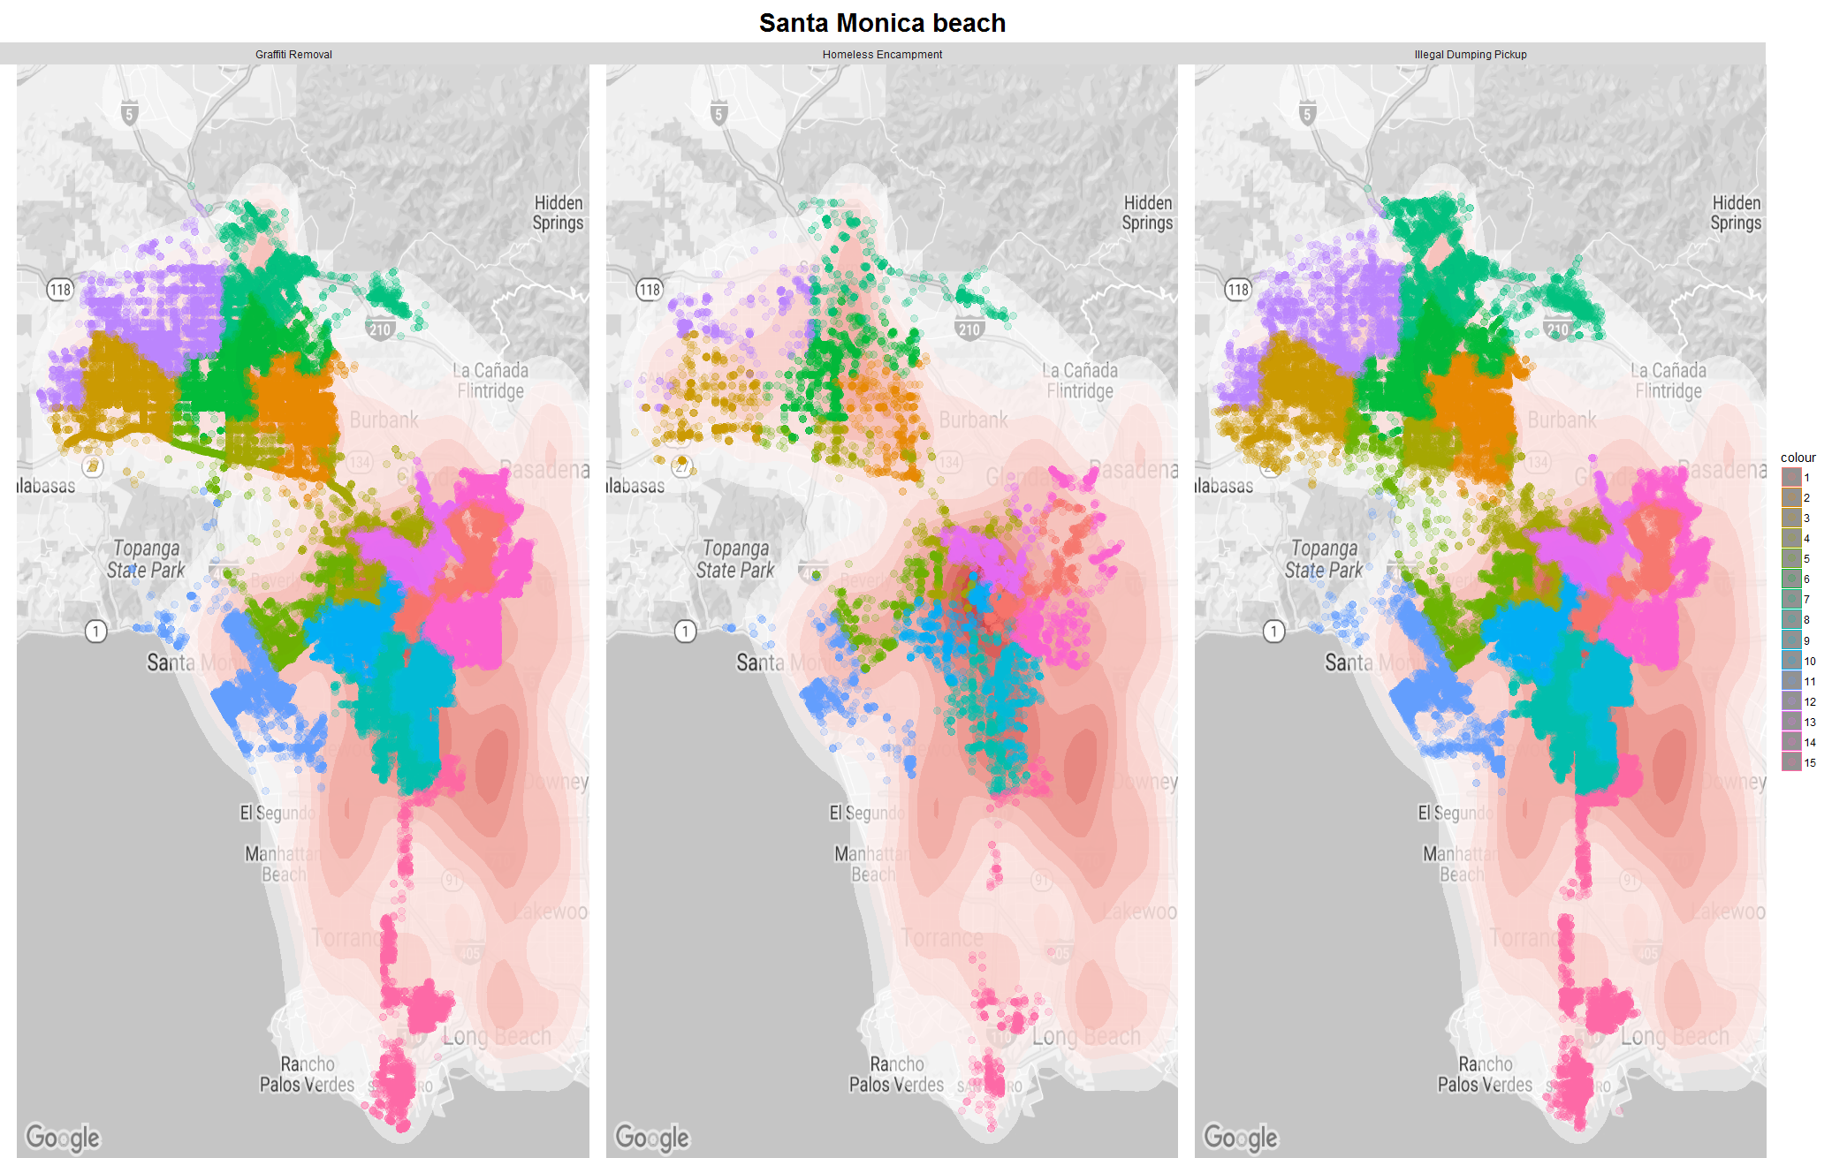
Special features – tourist attraction
Overview
Basic Distribution
Time Series/Efficiency
Maps
City Planning
Summary

Slide 25
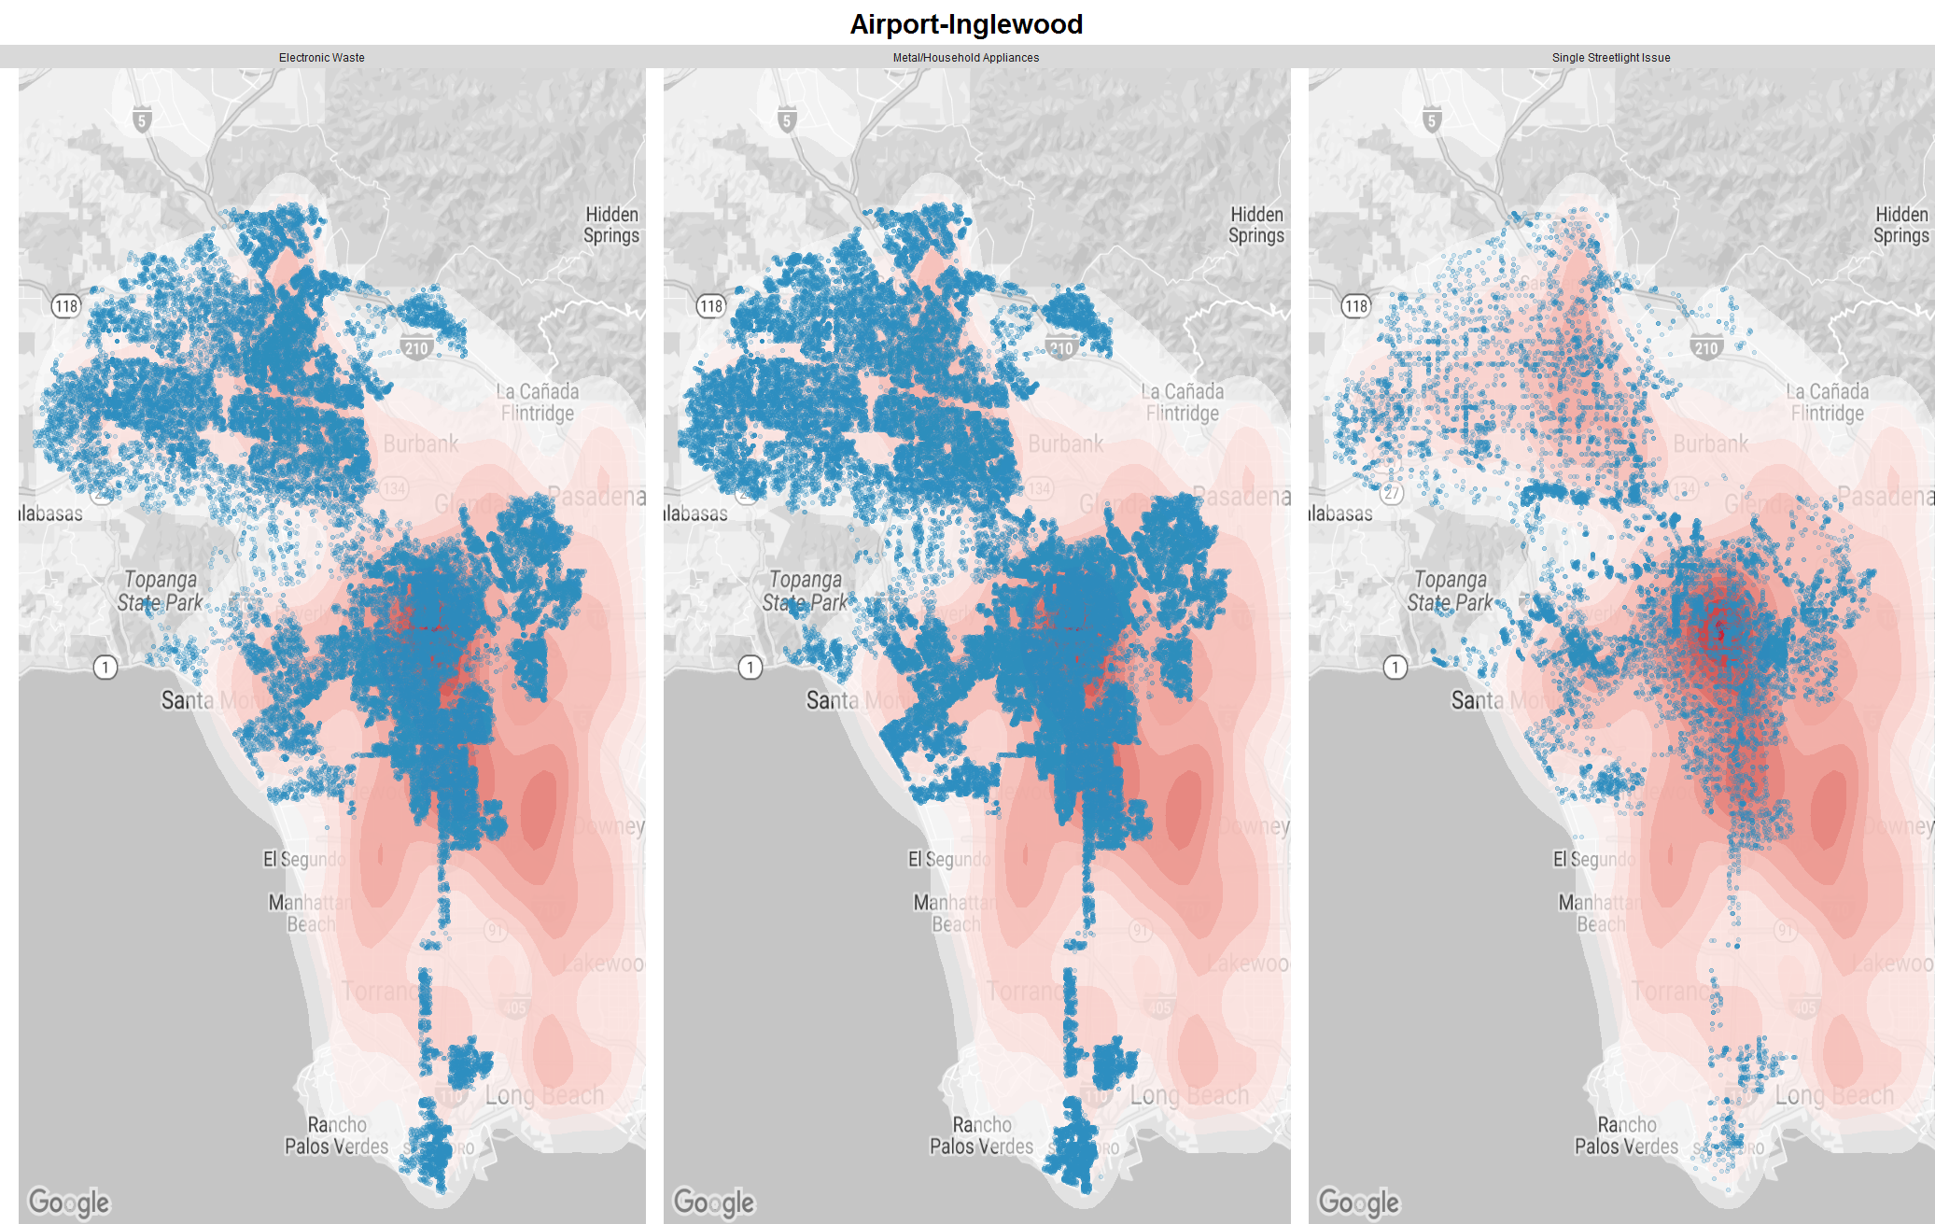
Special features – airport area
Overview
Basic Distribution
Time Series/Efficiency
Maps
City Planning
Summary

Slide 26
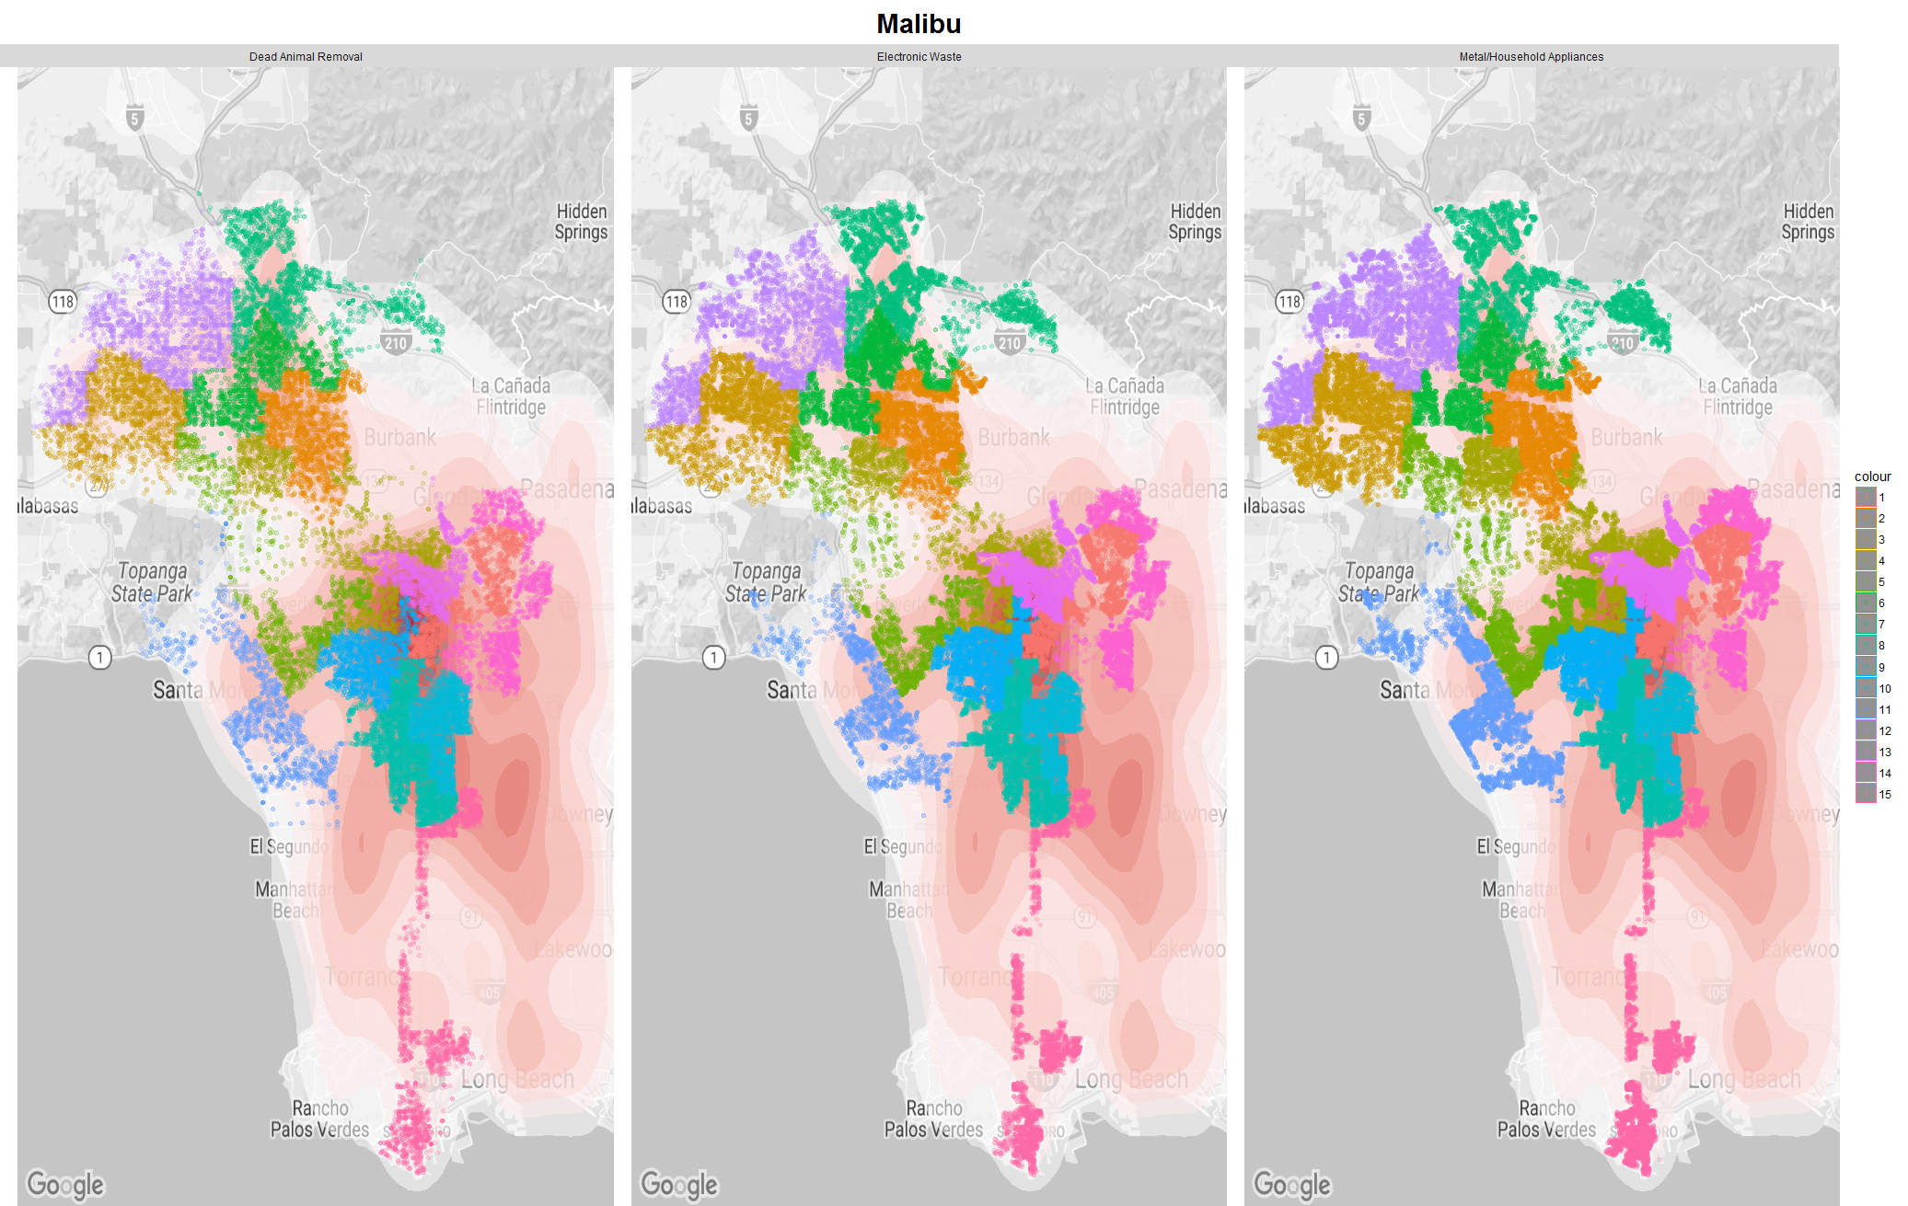
Special features
Overview
Basic Distribution
Time Series/Efficiency
Maps
City Planning
Summary

Slide 27
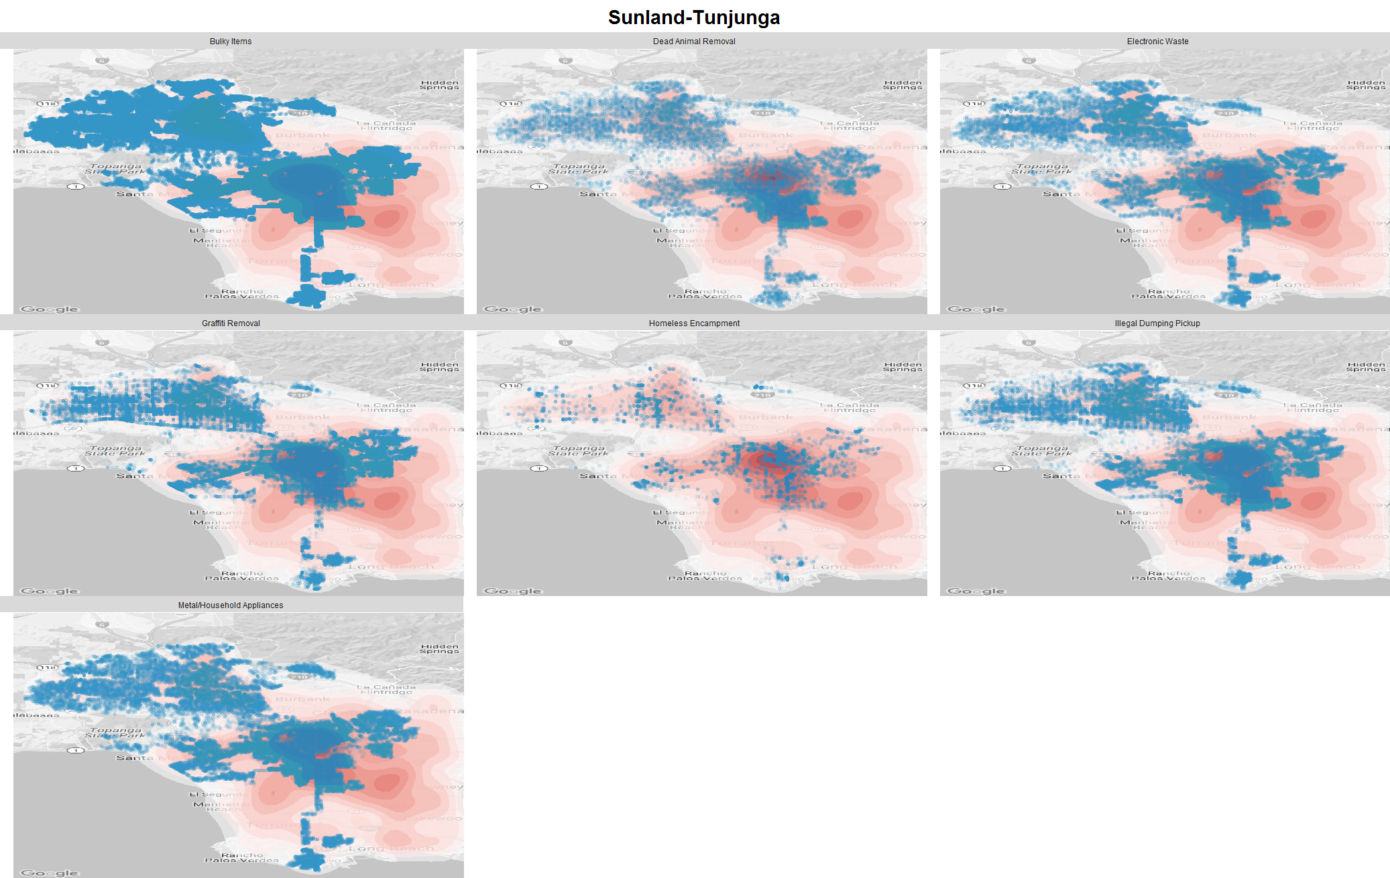
Abnormality
Overview
Basic Distribution
Time Series/Efficiency
Maps
City Planning
Summary

Slide 28
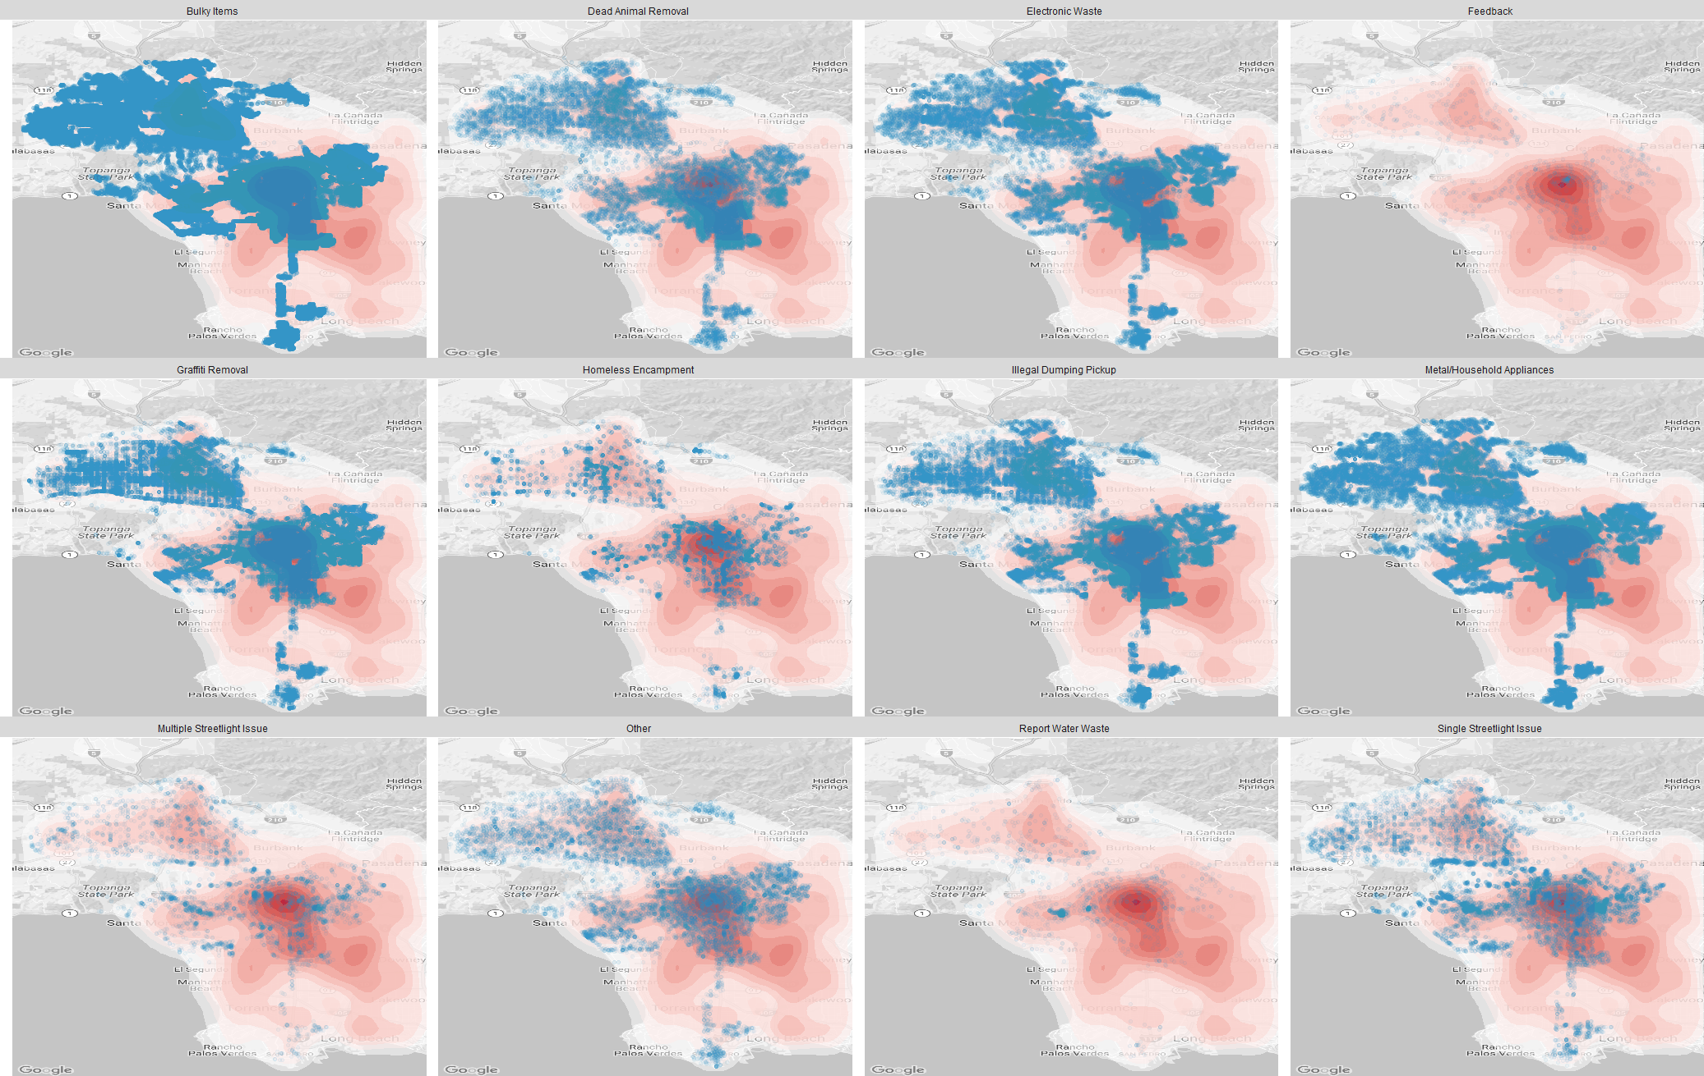
Breakdown in population map
Overview
Basic Distribution
Time Series/Efficiency
Maps
City Planning
Summary

Slide 29
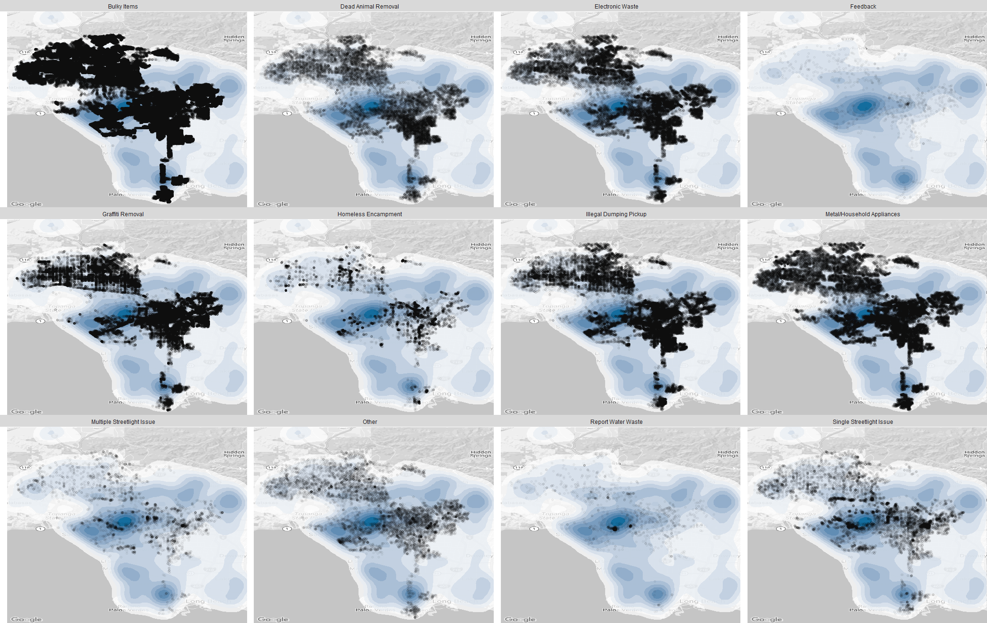
Breakdown in income map
Overview
Basic Distribution
Time Series/Efficiency
Maps
City Planning
Summary

Slide 30
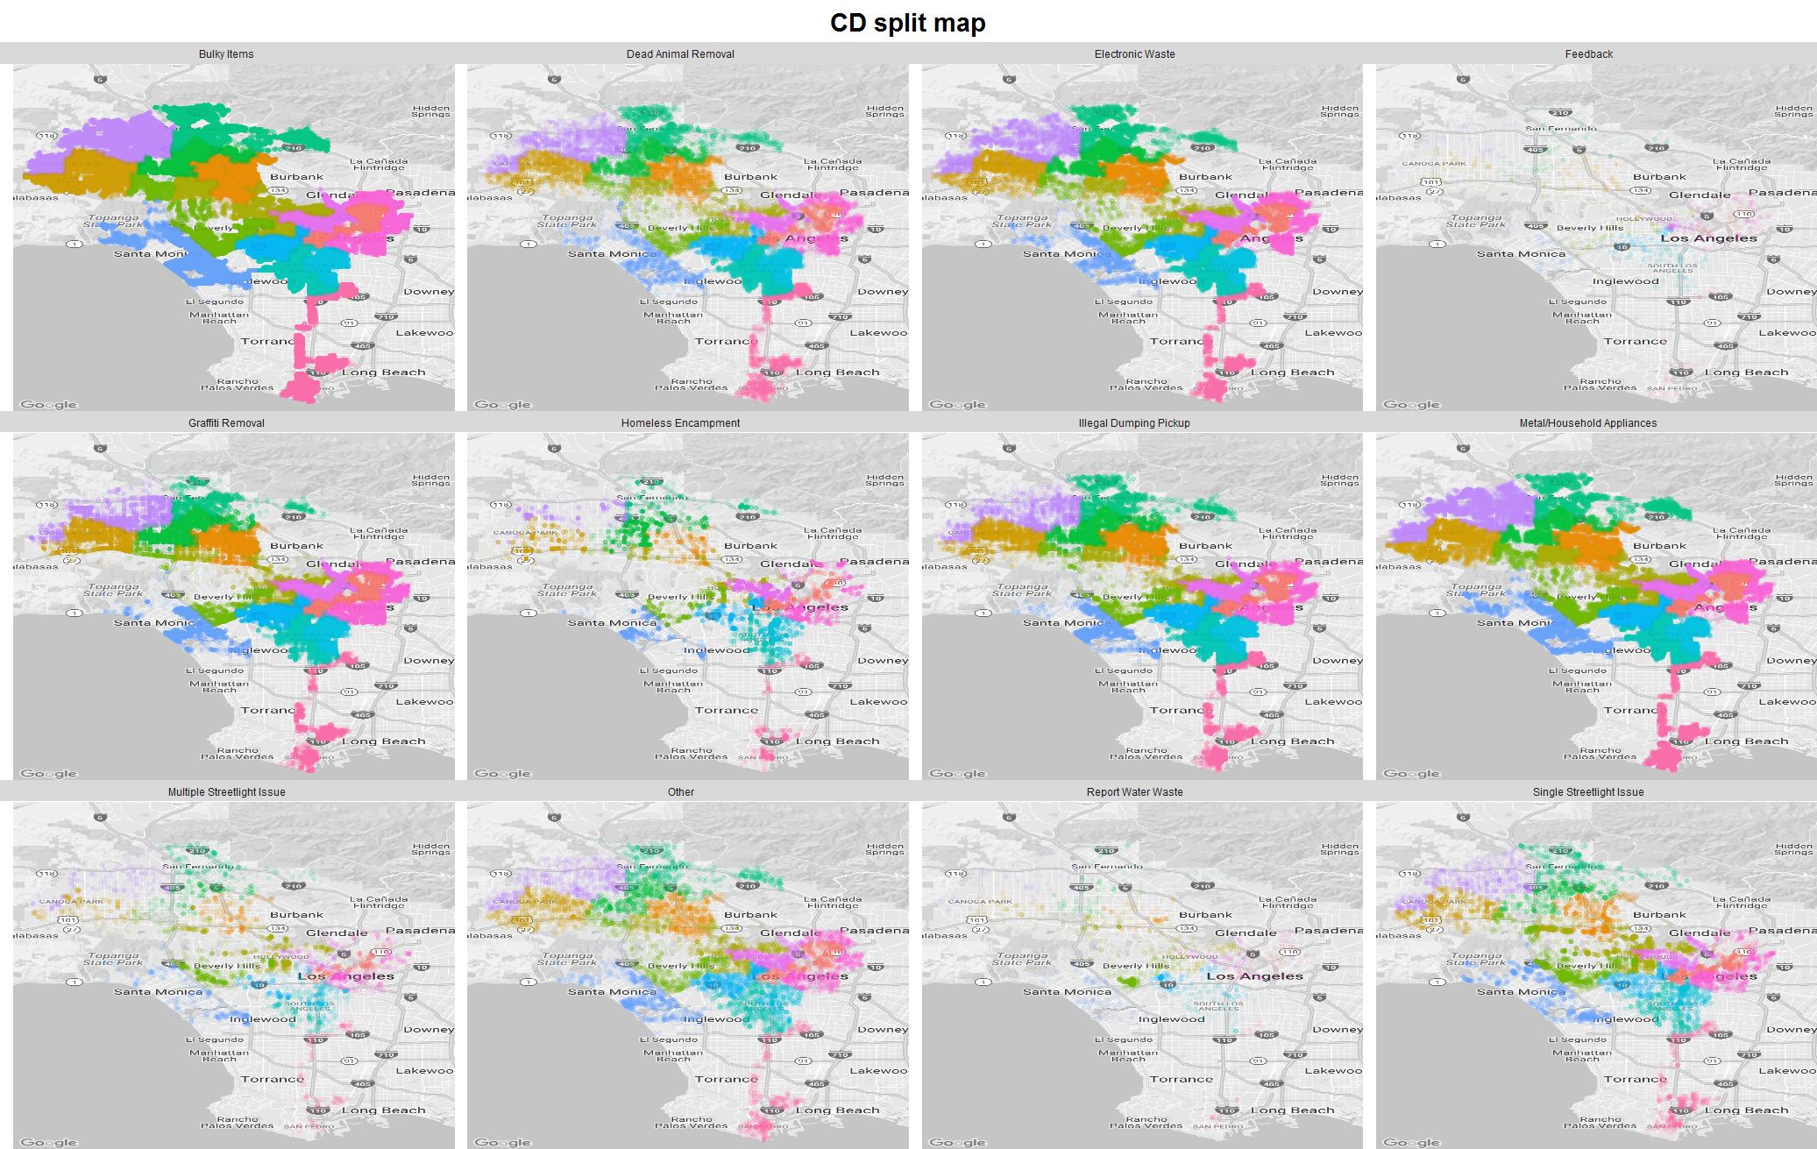
Breakdown in council map
Overview
Basic Distribution
Time Series/Efficiency
Maps
City Planning
Summary

Slide 31
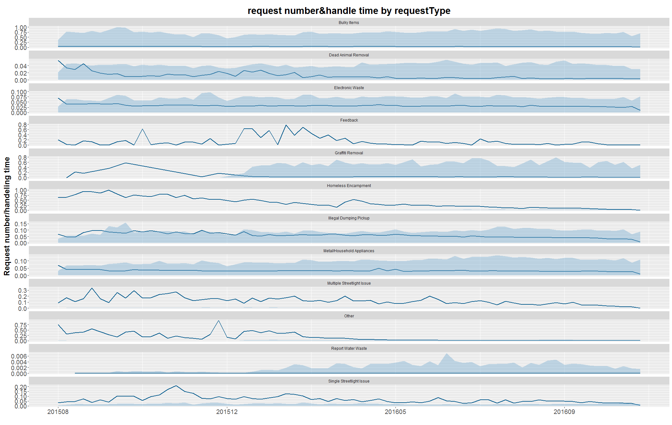
Breakdown exploration
Overview
Basic Distribution
Time Series/Efficiency
Maps
City Planning
Summary

Slide 32
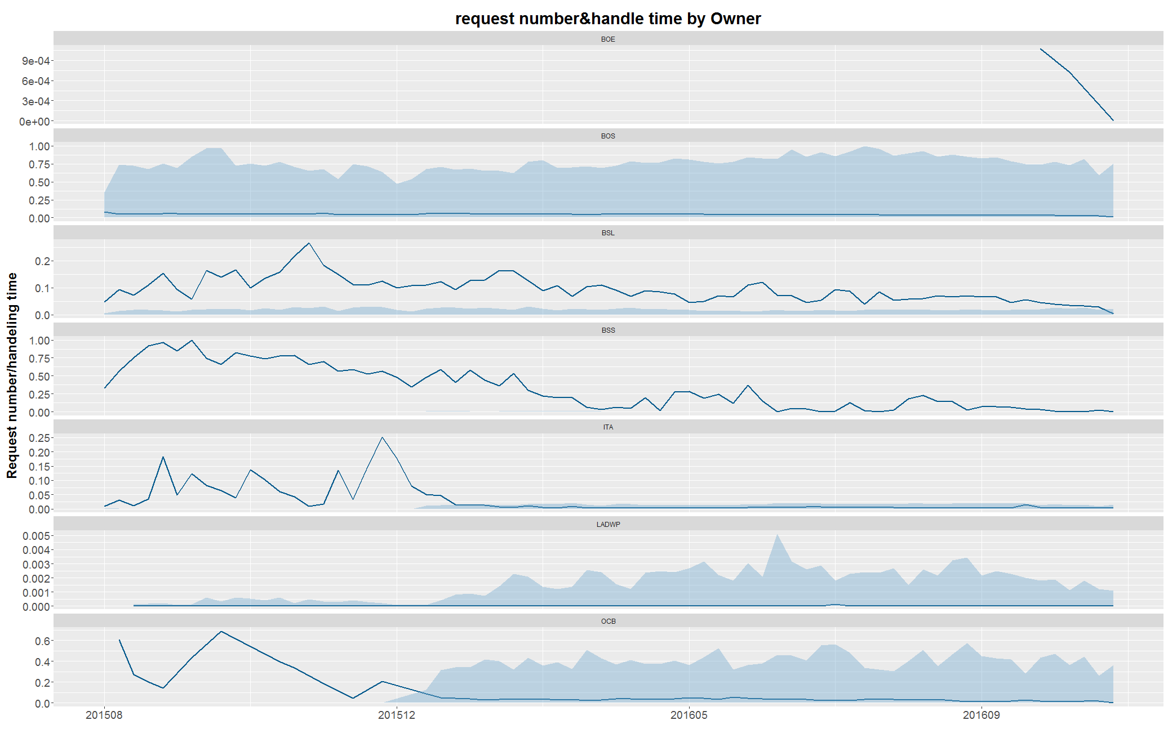
Breakdown exploration
Overview
Basic Distribution
Time Series/Efficiency
Maps
City Planning
Summary

Slide 33
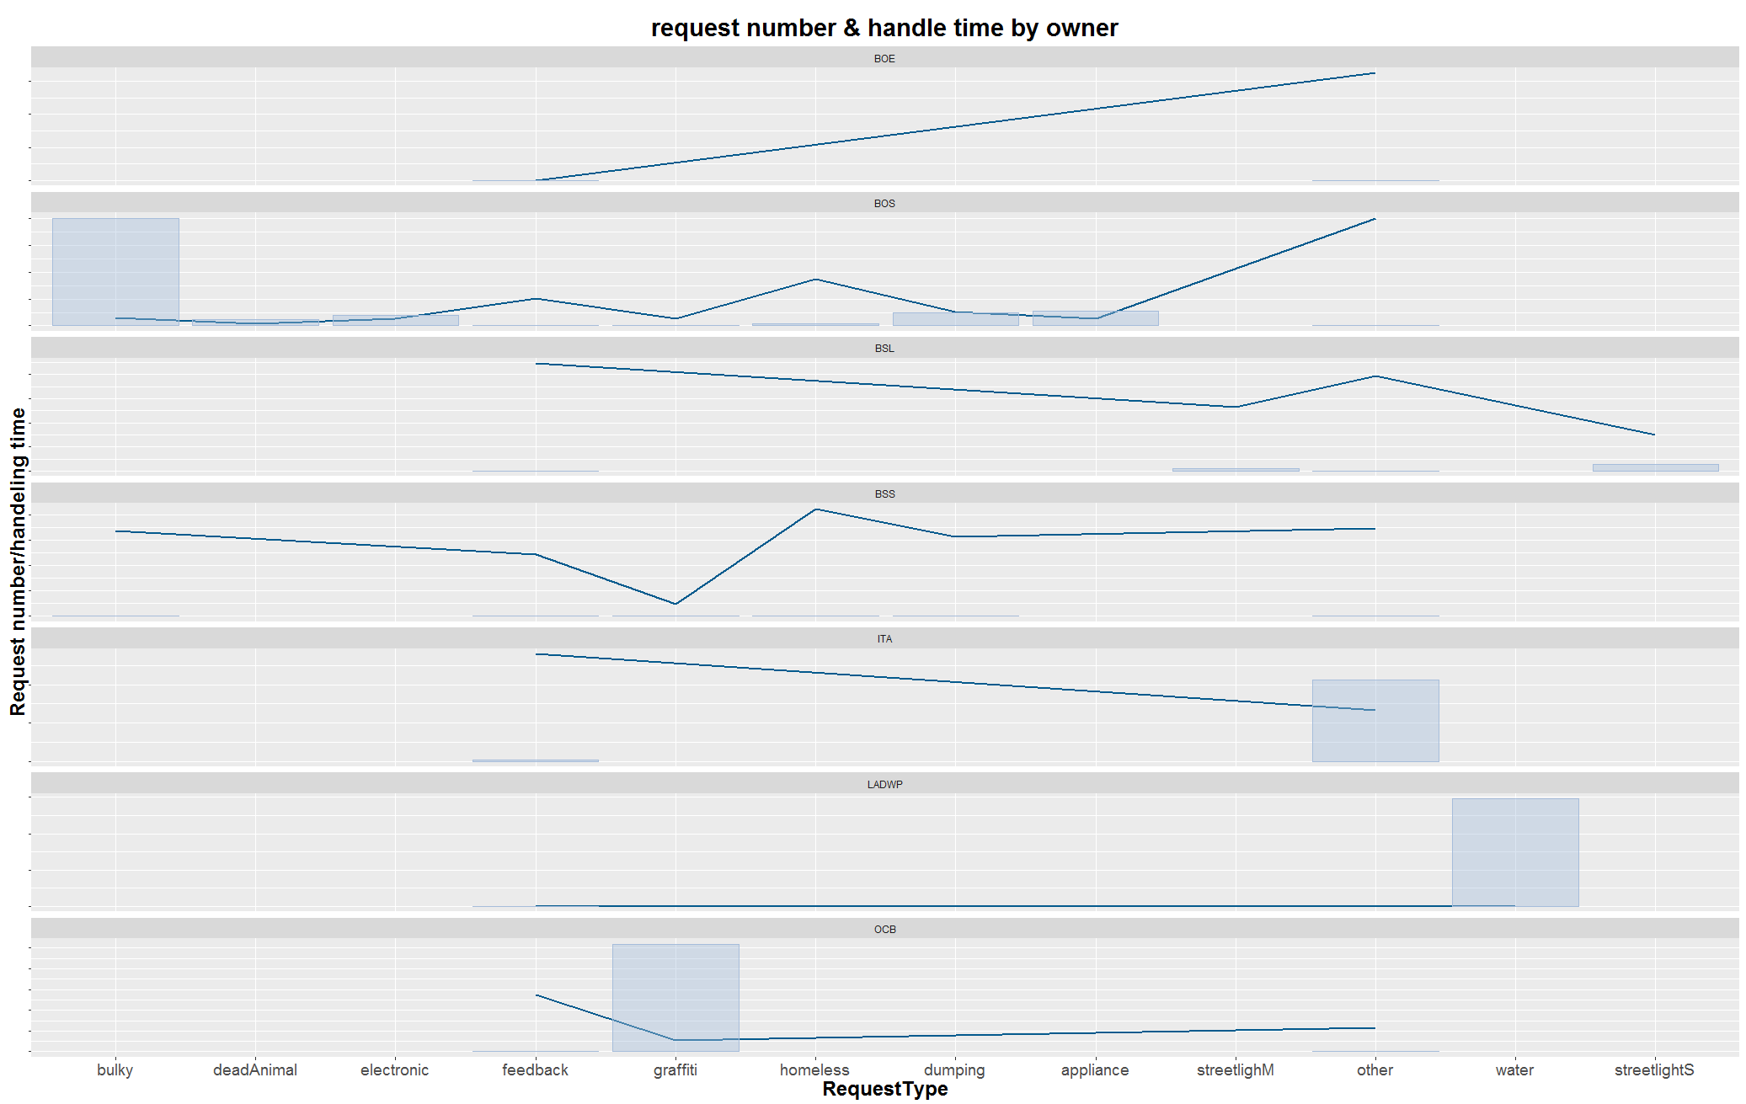
Breakdown exploration
Overview
Basic Distribution
Time Series/Efficiency
Maps
City Planning
Summary

